Slide 1
SPIRAL1
Flash talk & discussions

Slide 2
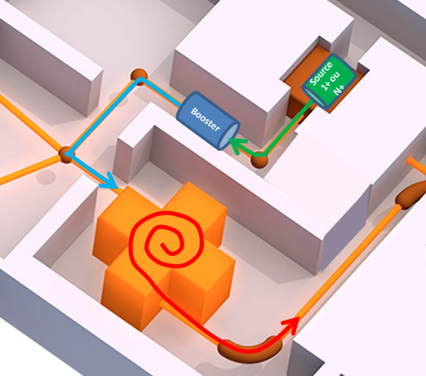
SPIRAL1 : Machine status
CF31
TISS
N+
CF41
1+
CF13
CF81
Phase | Objectives Initial | 2021 ⁴⁷K¹⁰⁺ 7MeV/A
Production (Ar) | 10% | <20%
1+ to N+ transport | 80% | >80%
Charge Breeding | 5-10% | 8%
Extraction N+ | 50% | 80%
CIME | 20% | <20%
CF11
Machine is now reliable, and efficiencies are in accordance with initial objectives

Slide 3
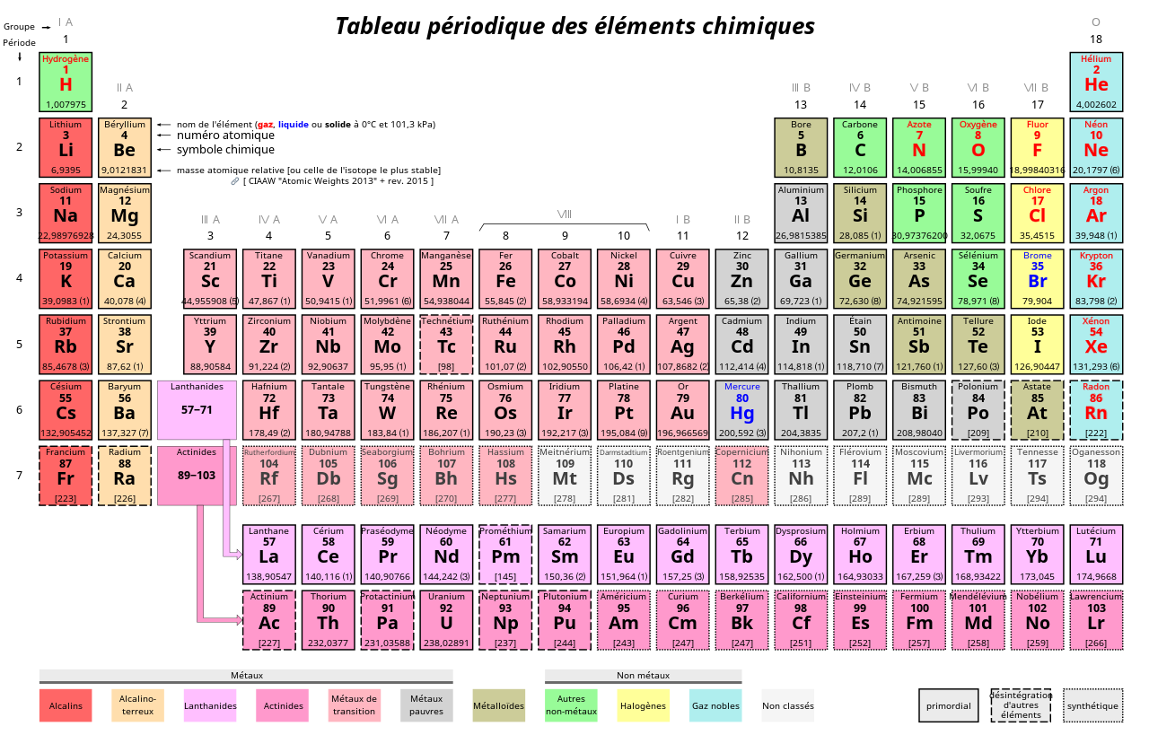
SPIRAL1 : Production
Available TISS - Fragmentation
Under development
SIS
FEBIAD
Nanogan3
Fusion-evaporation
Discussions for future developments :
Increase production (target, prim. Beam, …)
Purity (prim. beam, molecule, Laser, …)
Variety (fusion evaporation, new TISS, …)
to be checked

Slide 4
SPIRAL1 : Laser ion source
Discussion with N. Lecesne
Reference :
« Ion beam production and study of radioactive isotopes with the laser ion source at Isolde »
Valentin Fedosseev et al – 2017 J. Phys. G : Nucl.Part. Phys. 44 084006
ISOLDE ions beams produced with Lasers
SPIRAL1 Target fragmentation process up to Nb
Ionization schemes existing :
Publication
Development of new ionization schemes have to be done if unknown
    Could be done on GISELE tests bench according to source availability

Slide 5
SPIRAL1 : Laser ion source
Discussion with N. Lecesne
Technical installation :
Laser devices, equipements and infrastructure requirements are well known (GISELE, S3)
Define the best location
Safety authorization :
Some Laser installations are already studied at GANIL (GISELE, S3)
Technical solutions are already developed for fire protection and nuclear ventilation constraint.
Interne authorization should be ok, but have to be check with a more precise project
Cost :
Laser equipement : 500k€
Laser room and infrastructure : 180k€ (S3)
Human ressource :
1 reseach engineer + 1 PhD to adapt TISS, install Laser and develop ionization schemes

Slide 6
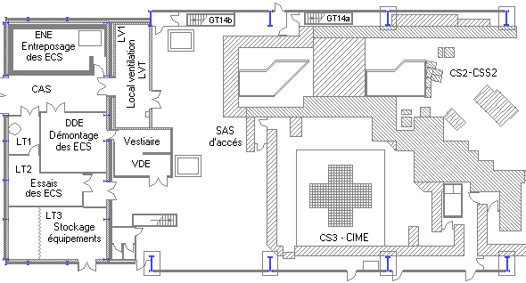
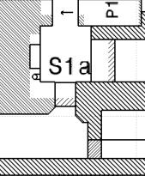
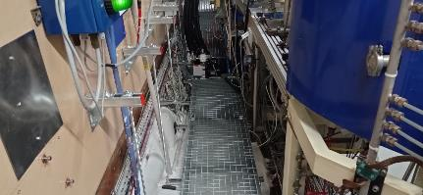
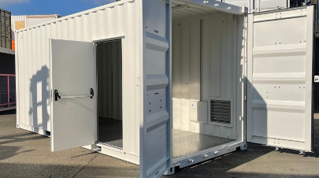
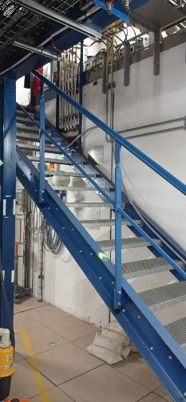
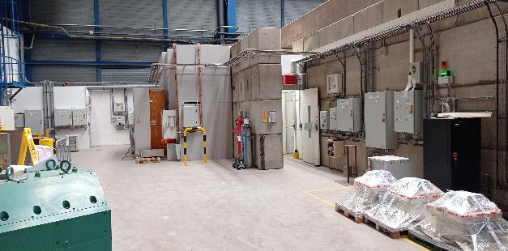
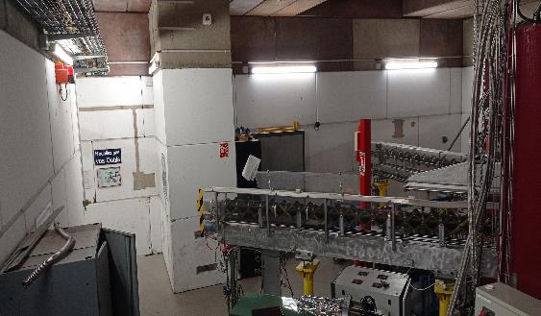
SPIRAL1 : Laser ion source
  Orange : 0 level
  Bleu : Underground
Laser system
ECS
D1P
Laser room
Laser room

