Slide 1
SPIRAL 2 - status
Hanna Frånberg Delahaye

Slide 2
Outline of my talk
GANIL – SPIRAL 2 were are we?
Statistics of operation

Slide 3
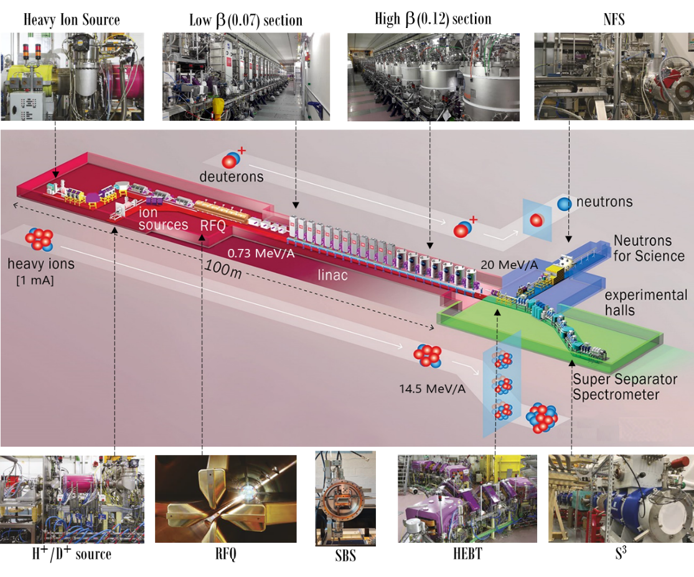
GANIL-SPIRAL2
Particles | H⁺ | D⁺ | Ions
A/Q | 1 | 2 | 3
Max I (mA) | 5 | 5 | 1
Max energy (MeV/A) | 33 | 20 | 14
Max beam power (kW) | 165 | 200 | 44
July 8th, 2019 Administrative authorization to operate SPIRAL2

Slide 4
Main commissioning dates and milestones
2021
A/q=2 ⁴He²⁺ at I=1,3 mA E=20MeV/A
D+ at I=5mA E=20MeV/A (using sbs)
NFS : I=50µA
2022
A/q=3 ¹⁸O³⁺ at 60keV ion source.
LHE : 7 MeV/A I= 800µA
LHE – no acceleration : 0,7MeV/A
Milestones
J1: Injector qualification with beam on the D-plate
J3: LINAC RF power qualification
J4: LINAC beam up to the beam dump
J5: Beam in NFS experimental hall
J6: Beam in S³ experimental hall (after the completion of S³)

Slide 5
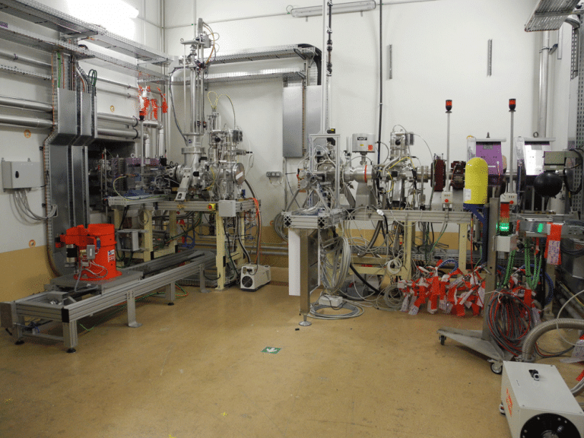
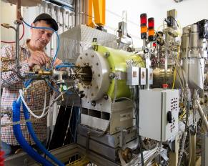
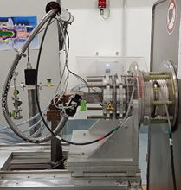
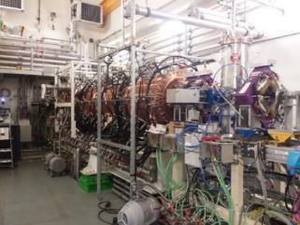
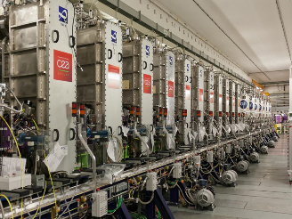
Commissioning Time Line
ECRIS
A/Q=3
1mA
ECRIS
H⁺, d⁺
5 mA
MEBT
LINAC
Beam Dump
RFQ
D-plate
LEBT
NFS
S³
SBS @ 5 mA H⁺.
MEBT @1.2 mA ⁴He²⁺
SBS* @1.2 mA ⁴He²⁺
SC LINAC @ 5 mA H⁺
16kW H⁺
July – December
Diagnostic plate commissioning end
April-November
P/D source:
first beam
2 mA H⁺.
December
2014
2015
2018
2019
2020
2021
MEBT @5 mA H⁺.
SBS* @ 0.2 mA H⁺
SC LINAC @ 0.2 mA H⁺
33MeV H⁺
July-December
SC LINAC@1.3 mA ⁴He²⁺
SBS @ 5 mA D⁺
SC LINAC @ 5 mA D⁺
40 MeV D⁺
50 µA NFS
July-September
Phoenix V2: first beam 230 µA Ar⁹⁺
July.
RFQ: first H⁺ beam December.

Slide 6
Exploitation

Slide 7
Operation of LINAC – SPIRAL 2
Increasing operation time for SPIRAL 2 and GANIL.
2019-2020-2021 majority of time for machine learning.
2021 : 750 h for physics of total 3046 h for running.

Slide 8
2020 et 2021
Notes:
Tuning of the LINAC 32% → 21% 730h→570
Unused beams 39 % → 16 % 920 →430h
Physics 9% → 24 % 280 h→ 680h
Technical difficulties 400→ 890h
The pourcentage of physics was went up due to the availability of deutron beams in NFS
The amount of technical issues went up due to the comissioning of the machine

Slide 9
Experiments at NFS
Carac 0
Carac 1 | Conv mince Li Be | 11 MeV d+
Carac 2 | Conv rotative | 20 MeV d+
E800_20 |  | 20 MeV d+ I=47µA
E811_20 |  | d+ I=10µA 20MeV/A
E807_20 |  | d+ I=10µA 20MeV/A
E799_20 |  | p+ I=300nA 33MeV
LoI – 5 |  | p+ I=20µA 33MeV
LoI – 9 |  | 20 MeV d+ I=47µA

Slide 10
Operation
2020
The LINAC proton acceleration at 16 kW was accomplished.
Full operation 24h/24 7d/7 was put in place.
2021
3 runs:
Deuterons 20 MeV/A
Tests :
ACCT/DCCT
Bunch selector
Optimisation of tuning with different frequencies
Modification of the scrapper
BPM (noise reductions,
Experiments with neutron converter at NFS
Characterisation of converters

Slide 11
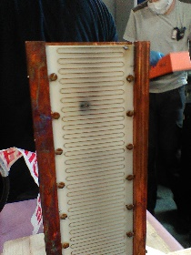
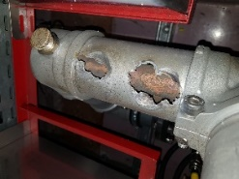
Technical issues 2020 and 2021
Due to the operation of deuteron beams and higher power achieved in 2021 the technical issues also increased.
Some of the necessary modifications were:
the beam bunch selector equipment. A new design was made and installed for the run 2022
Spare equipment's for the power supplies for the same has been foreseen.
A RF tube for one of the cavity underwent serious damages and was exchanged.
The deuteron source had isolation difficulties on the RF tube.
A modification of the filters for the RF tubes for the RFQ was obligatory .
Various modifications of the beam diagnostics and monitoring were performed while gaining knowledge of their behaviour with beam.
New algorithms for tuning of the cavities - Control systems
Changes in the alarm system for the different equipment.
Faster intervention time 24h/7

Slide 12
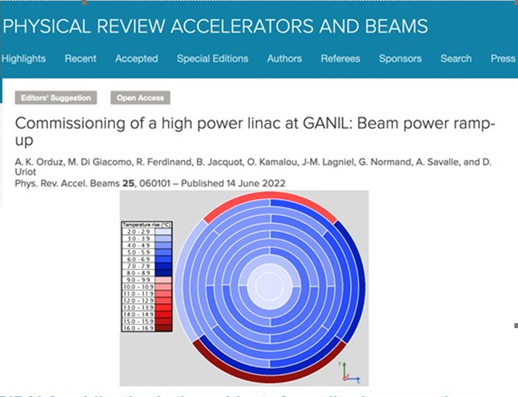
High lights

Slide 13
Technical talks this week :
Monday
Session 4: SPIRAL 1 beams
Wednesday:
Session 3: CSS renovation sessions
Thursday:
Session 3: Inter-facility developments
Session 4: SPIRAL2 : Accelerator Perspective
Friday
Session 1: DESIR
I wish you a very nice conference and plenty of discussions.

