Slide 1
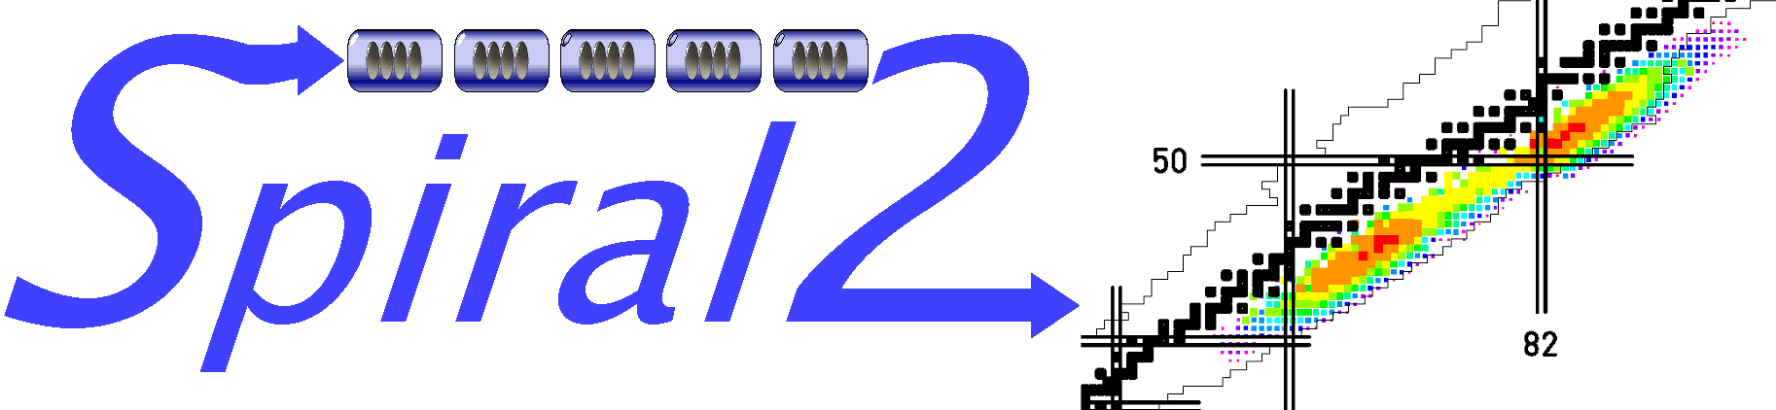
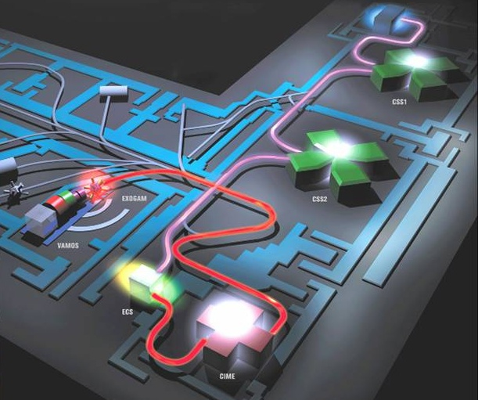
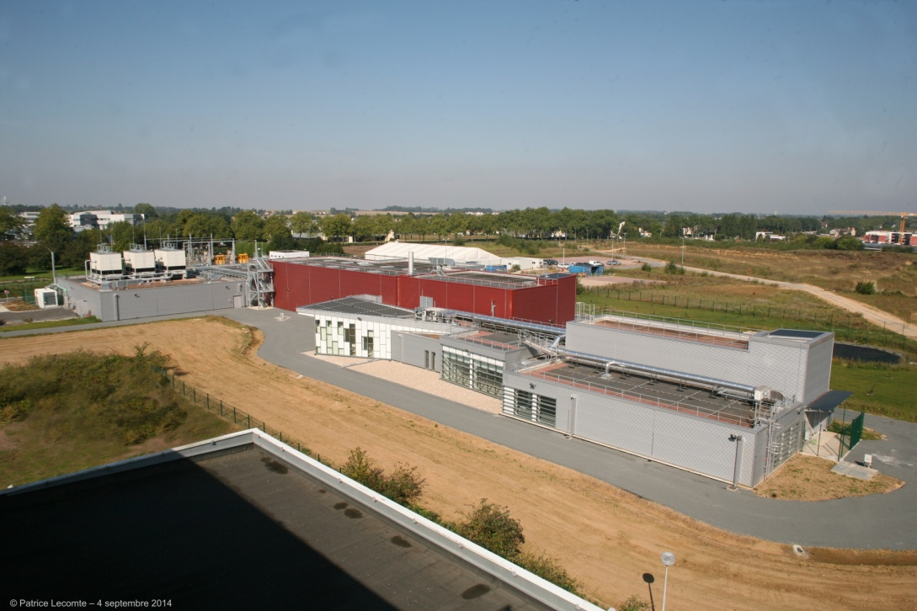
GANIL OPERATION STATUS (CYCLOTRONS AND SPIRAL1)
O. Kamalou and GANIL staff
GANIL, Grand Accélérateur National d’Ions Lourds, Caen, France
GANIL-CAEN
17-21 Octobre 2022

Slide 2
OUTLINE
Operating modes at GANIL
Running statistic
Failures
SPIRAL 1 upgrade and some results

Slide 3
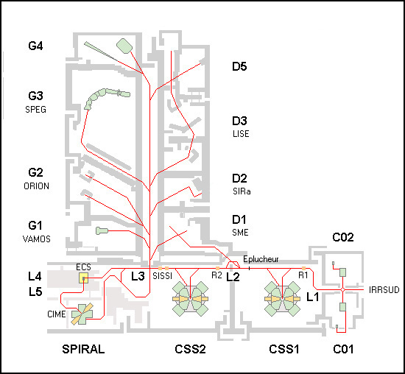
Operating Mode at GANIL
4
Radioactive Ion Beam to LIRAT or experimental rooms via CIME
Beam: ⁵⁸Ni²⁶⁺ @75 Mev/A
Target: Be@600 µm
Weedg: Be@530 µm
3
High Energy Beam GANIL [< 95] MeV/u to SPIRAL Target-Ion-Source-System
4D-imaging of drip-line radioactivity by detecting proton emission from ^{54m}Ni pictured with ACTAR TPC
2,6 10⁶ pps
4
2
SME: after a stripper, one charge state is sent to the D1 room => the medium energy exit [3.7, 13.7] MeV/u
EXOGAM
2
3
Stripper
IRRSUD: low energy beam irradiation line
[0.3, 1.0] MeV/u
LIRAT
<34keV/u
1
1
CIME
1.2 – 25 MeV/u

Slide 4
Intense Primary beams
Beam | Imax [μAe] | [pps] <2 10¹³ | Emax [MeV/A] | Pmax [W] <6kW | Used with Spiral
¹²C⁶⁺ | 18 | 1.9 10¹³ | 95 | 3 200
¹³C⁶⁺ | 18 | 2. 10¹³ | 80 | 3 000 | X
¹⁴N⁷⁺ | 15 | 1.4 10¹³ | 95 | 3 000
¹⁶O⁸⁺ | 16 | 10¹³ | 95 | 3 000 | X
¹⁸O⁸⁺ | 17 | 10¹³ | 76 | 3 000 | X
²⁰Ne¹⁰⁺ | 17 | 10¹³ | 95 | 3 000 | X
²²Ne¹⁰⁺ | 17 | 10¹³ | 79 | 3 000
²⁶Mg¹²⁺ | 20 | 10¹³ | 82 | 3 600 | X
³⁶S¹⁶⁺ | 11 | 5 10¹² | 77.5 | 1100 | X
³⁶Ar¹⁸⁺ | 16 | 5.5 10¹² | 95 | 3 000 | X
⁴⁰Ar¹⁸⁺ | 17 | 6. 10¹² | 77 | 3 000
⁴⁸Ca¹⁹⁺ | 4-5 | 1.3 10¹² | 60 | 600-700 | X
⁵⁸Ni²⁶⁺ | 5 | 1.2 10¹² | 77 | 860
⁷⁶Ge³⁰⁺ | 5 | 1.2 10¹² | 60 | 760
⁷⁸⁻⁸⁶Kr³⁴⁺ | 7.5 | 1.4 10¹² | 70 | 1200 | X
¹²⁴ Xe⁴⁶⁺ | 2 | 2.7 10¹¹ | 53 | 300
2.10¹³ pps Safety limitation/target reached
talk: New stable beam developments: F, Lemagnen on Thursday@14h15
Possible improvement

Slide 5
New phenix V3 ions source for C02 injector
Beam | Present Intensities(μA) | Phoenix V3 | Expected Gain | Interest
⁴⁰Ca¹⁰⁺ | 15 | 30 | 2 | Spiral1 ++ Desir ++ LISE ++
⁵⁸Ni¹¹⁺ | 15 | 35 | > 2
⁶⁴Ni¹⁵⁺ | 1-2 | 30 | > 15
⁷⁸⁻⁸⁶Kr¹⁵⁺ | 30 | 100 | > 3
¹²⁹⁻¹³⁶Xe²⁰⁺ | 5-10 | 100 | 10 | Applications
²³⁸U³¹⁺ | 0.4 | > 2 (?) | > 4 (?) | Fission + Applications
talk B. jacquot: New injector on Wednsday@14h40

Slide 6
Running statistic From 2001 to 2022
Total running time (2001-2022) : 88749 hours
(~4200 hours/year)
Total pilot time (2001-2021) : 60996 hours
(~2900 hours/year)
including SME-IRSSUD(~1329 hours)
The operation time is decreasing :
2012-2013 : installation of the new access system
Since then : human resources on installation/Operation of SPIRAL2

Slide 7
Operation from 2001 to 2022

Slide 8
Failures
talk: CSS renovation sessions on wedensday@14:00(The CYREN pre-project)
Principally due to Water leak Inside the machine (CSS, chapeau de gendarme, MSE3,…) and more!!

Slide 9
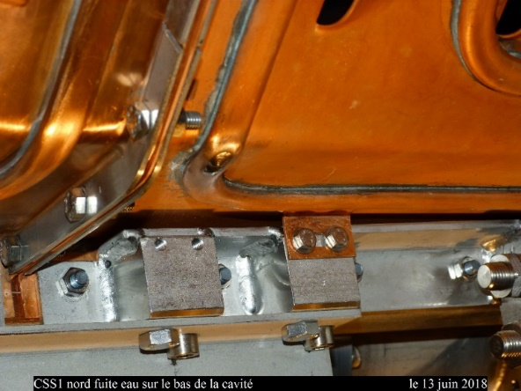
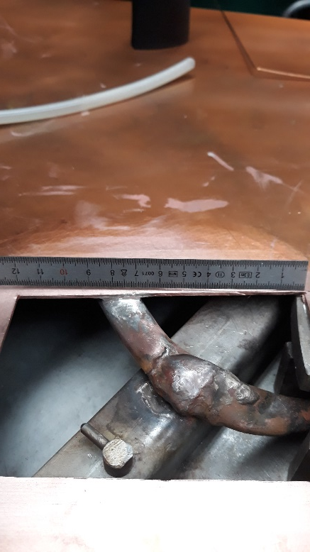
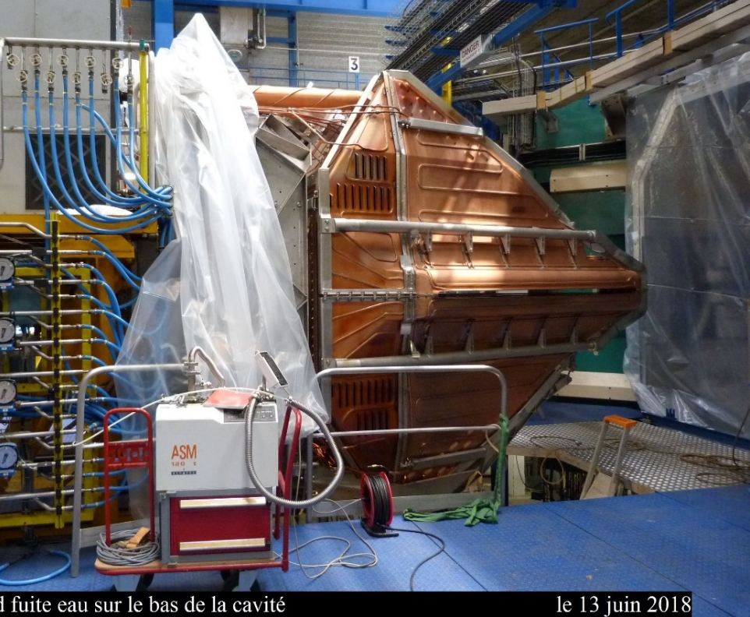
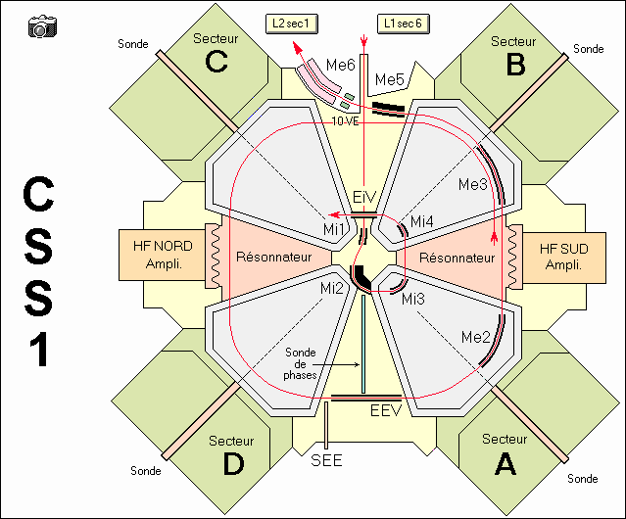
Troubles in 2019-2021
Water leak North RF Cavity CSS1
Tuning CSS1 with a lone cavity and injecting into CSS2 !

Slide 10
CSS tuning with a one cavity ( South)
Without the north cavity it is necessary to reduce the magnetic field in sectors D and A and increase it in sectors B and C
precession → difficulty to eject
=> AND the CSS1 output energy is not nominal (-4%!)
Difficulty to inject in CSS2
Use of rebuncher R2 as an accelerating cavity
CSS1 efficiency for O¹⁶ 95 MeV/A : 70-80 %; CSS2 : 80% and long beam tuning (6 UTs instead 3 UTs=time losses)
Not compatible with HI beam

Slide 11
Cyclotron cavities failures (Not available)
C01 Cavity:
  C02 can be used instead
  Non metalic beam can be accelerated
  Non Irrsud bead line
  More time for beam tuning (2 Uts)
C02 Cavity:
  C01 can be used instead
  Non Irrsud bead line
  More time for beam tuning (2UTs)
CSS1 Cavity South:
  Non beam to physics
CSS1 Cavity North:
  No THI mode (LISE/SPIRAL1 for exemple)
  Tunning not stable and not easy
  More time for beam tunning and T=70%-80%
CSS2 Cavity South:
  Beam from CSS1 could be send to physics (3,7-13,7 Mev/A)
CSS2 Cavity North:
  No THI mode (LISE/SPIRAL1 for exemple for beam not possible)
  Tunning not stable
  More time for beam tuning and T=70%-80%

Slide 12

SPIRAL 1 Operating Mode/upgarde
Stable & radioactive Accelerators
C ⇨ U from few eV/A up to 95MeV/A
High Energy Exotic Beam [1.2, 25]MeV/u
SPIRAL1 (2001-2014)
RIBs production

Slide 13
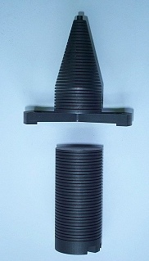
Target Ions Source ECR N+: Nanogan3+C
Highest ionisation efficiencies for gases!
6 kW ¹²C beam
Cold transfer tube
He, N, O, F, Ne, Ar, Kr
A. C. Villari et al., Nuclear Physics A 787 (2007) 126c–133c
To the cost of universality

Slide 14
Exotic beams production before upgrade
ions | W [MeV/u] | [pps] | ion | W [MeV/u] | [pps]
6He | 3.8 | 2.8 10⁷ | 20F | 3 | 1.5 10⁴
6He | 2.5 | 3.7 10⁷ | 17Ne | 4 | 4.10⁴
6He | 5 | 3.10⁷ | 24Ne | 4.7 | 2.10⁵
6He | LIRAT (<34 keV/u) | 2.10⁸ | 24Ne | 7.9 | 1.4 10⁵
6He | 20 | 5.10⁶ | 24Ne | 10 | 2 10⁵
8He | 3.5 | 1.10⁵ | 26Ne | 10 | 3.10³
8He | 15.5 | 1.10⁴ | 31Ar | 1.45 | 1.5
8He | 15.4 | 2.5 10⁴ | 33Ar | 6.5 | 3.10³
8He | 3.5 | 6.10⁵ | 35Ar | 0.43 | 4.10⁷
8He | 3.9 | 8.10⁴ | 44Ar | 10.8 | 2.10⁵
14O | 18 | 4.10⁴ | 44Ar | 3.8 | 3.10⁵
15O | 1.2 | 1.7 10⁷ | 46Ar | 10.3 | 2.10⁴
19O | 3 | 2.10⁵ | 74Kr | 4.6 | 1.5 10⁴
20O | 3 | 4.10⁴ | 74Kr | 2.6 | 1.5.10⁴
20O | 4 | 4.10⁴ | 75Kr | 5.5 | 2.10⁵
18Ne | 7 | 1.10⁶ | 76Kr | 4.4 | 4.10⁶
18F | 2.4 | 2 10⁴

Slide 15
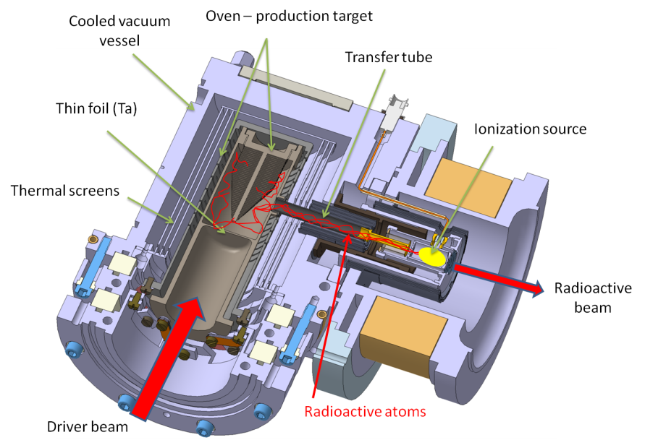
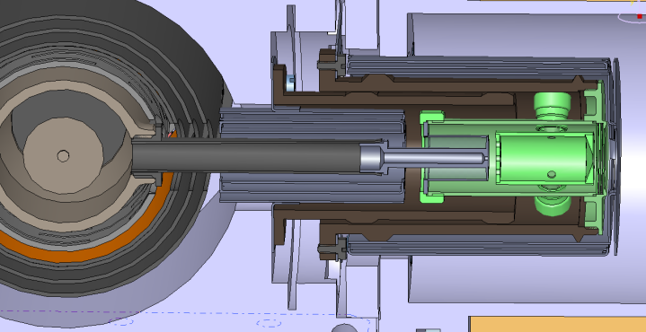
1+ FEBIAD source (type VADIS ISOLDE)/Booster installation between 2014-2017
FEBIAD ion source development since 2011
Main difficulty to overcome :
Thermal expansion of the transfer tube
Different Targets with C Beam, up to Nb
Transfer tube length :
20° : 62.5mm
2000° : 62,5 + 1.5mm
VADIS
Need to develop a system having a translation movement while conserving a good electrical contact (~350A)
Session: CSS: SPIRAL 1 on Monday@17h00
I : 350A
Non selective source : Mg, Ca, Sc, Cr, Mn, Co, Ni, Cu, Zn, Ga, Ce, As, Se, Al
But no acceleration by CIME (Q/A too low)
2011
FEBIAD: Forced Electron Beam Induced Arc Discharge

Slide 16
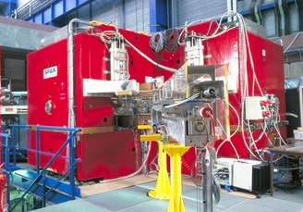
CIME : Post-accelerator requirements
Q/A
0.15
0.25
0.35
0.45

Slide 17
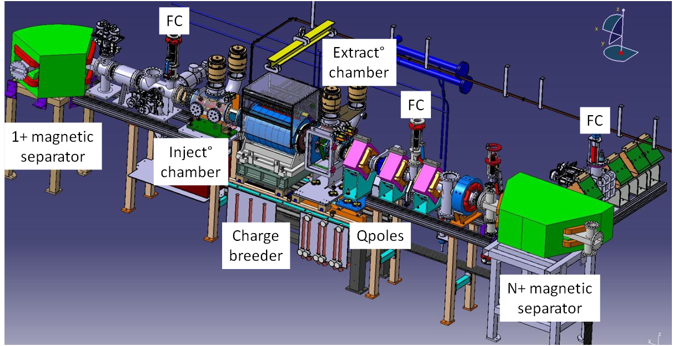
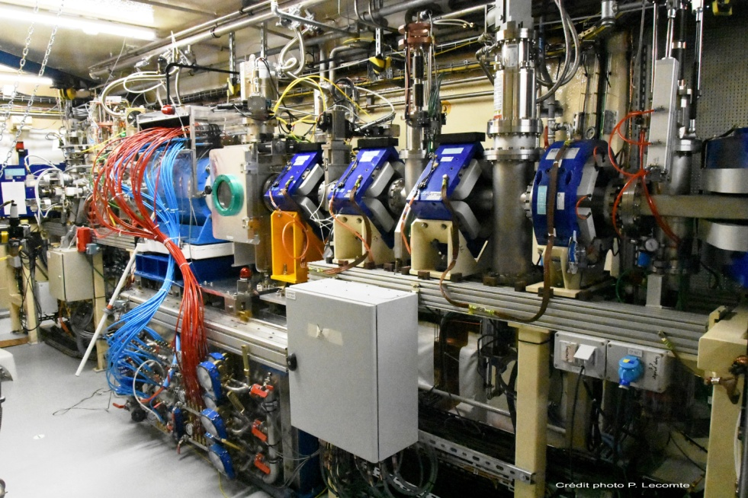
Charge Breeder Integration

Slide 18
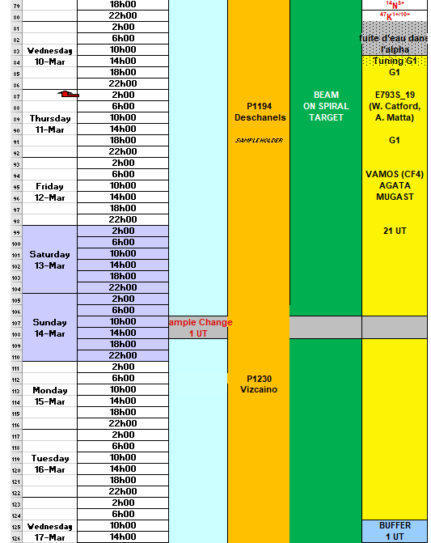
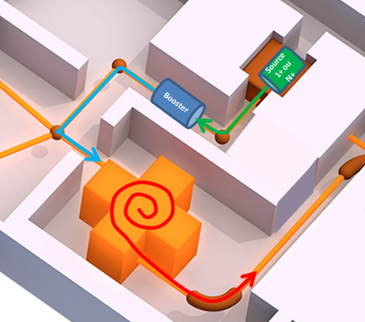
First experimente using FIBIAD+Booster+CIME
Phase | Objectives Project | 2019 ^{38m}K⁹⁺ 9MeV/A | 2021 ⁴⁷K¹⁰⁺ 7MeV/A
Production (Ar) | 10% | > 5% | >15%
1+ to N+ transport | 80% | >80% | >80%
Charge Breeding | 5-10% | 1.5% | 8%
Extraction N+ | 50% | 80% | 80%
CIME | 20% | <25% | <25%
R&D since the last 2 years permit to have an long production
period with efficiencies required for the machine (TISS + CB)
Session: CSS: SPIRAL 1 on Monday@17h00
Next steps :
- 1+ source : Develop the radioactive beam (A>40)
- Charge Breeder : Improve it versatility
CF31
TISS
CF41
N+
1+
CF13
CF81
EMIS 2022: P. Chauveau et al,
CF11

Slide 19
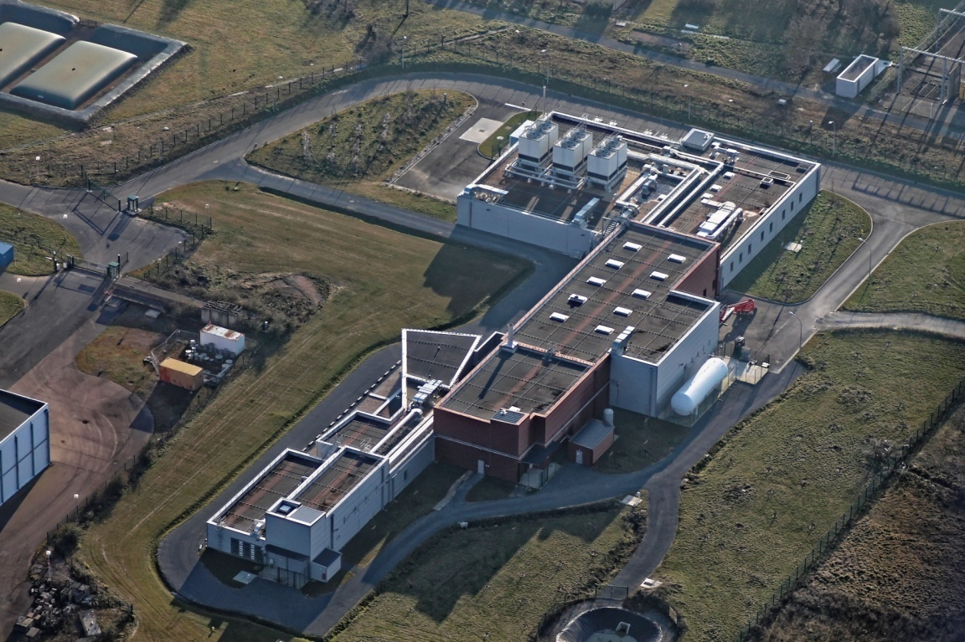
Thank you for your attention

Slide 20









CSS1 cavities not available
coupling between 2 cyclotron C01 and CSS2
$\frac{Rco1ej}{Rcss2inj}$=$\frac{hco1 }{hcss2}$
$Rco1ej$ =48,82 cm
$Rcss2inj$ =120 cm
$$hco1 =3$$
$$hcss1 =5$$
$$with hcss2=5$$
Not possible to injecte the beam to CSS2
$$with hcss2=7$$
$Rco1ej$ =50,9 cm
$Rcss2inj$ =118,8 cm
Is between 1,88 Mev/A -7 Mev/A
Maching study should be done

