Slide 1
Development prospects for the SPIRAL2 accelerator an overview of technical optimization activities
Pierre-Emmanuel Bernaudin
GANIL/DOD

Slide 2
Foreword
This presentation is an accelerator perspective, based on the developments and evolutions already planned (or at least analyzed).
New ideas and prospects, in particular those proposed and discussed in this GCM, are obviously not shown here!
Also, beam dynamics, sources and NewGain topics will not be covered here (see relevant presentations).
GANIL Community Meeting 2022 – Caen – P.-E. Bernaudin
2

Slide 3
Introduction
SPIRAL2 is:
a new machine (in operation since Summer 2019) – but designed 15-20 years ago; some systems are already obsolescent
a machine designed for high intensity but used for low intensity beams
Availability: a lot of improvement since 2019, but still work to do to minimize beam downtime:
  Improving reliability of technical systems
  Making repairs simpler and faster (systems optimization, spares procurements)
  Optimizing beam operation : beam tuning, beam switch, alarms management, GUI optimization for operators, procedures, training of on-call people and operation engineers
A lot of ideas.
A lot of work to be done.
Unfortunately, limited resources to deal with (budget and manpower).
GANIL Community Meeting 2022 – Caen – P.-E. Bernaudin
3

Slide 4
Outlook
Introduction
Beam diagnostic developments
RF system developments
  Focus on the superconducting cryomodules
Controls
Conclusion
GANIL Community Meeting 2022 – Caen – P.-E. Bernaudin
4

Slide 5
Beam diagnostic developments
GANIL Community Meeting 2022 – Caen – P.-E. Bernaudin
5

Slide 6
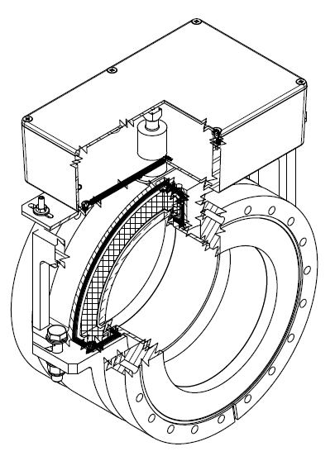
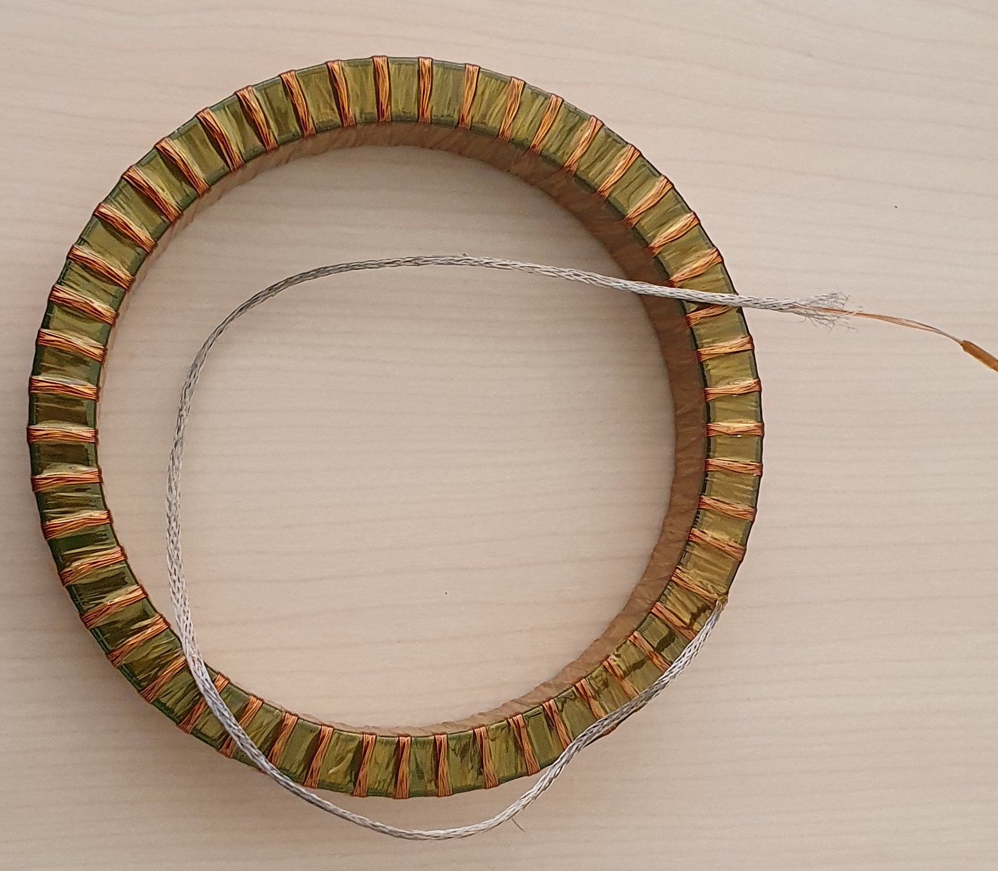
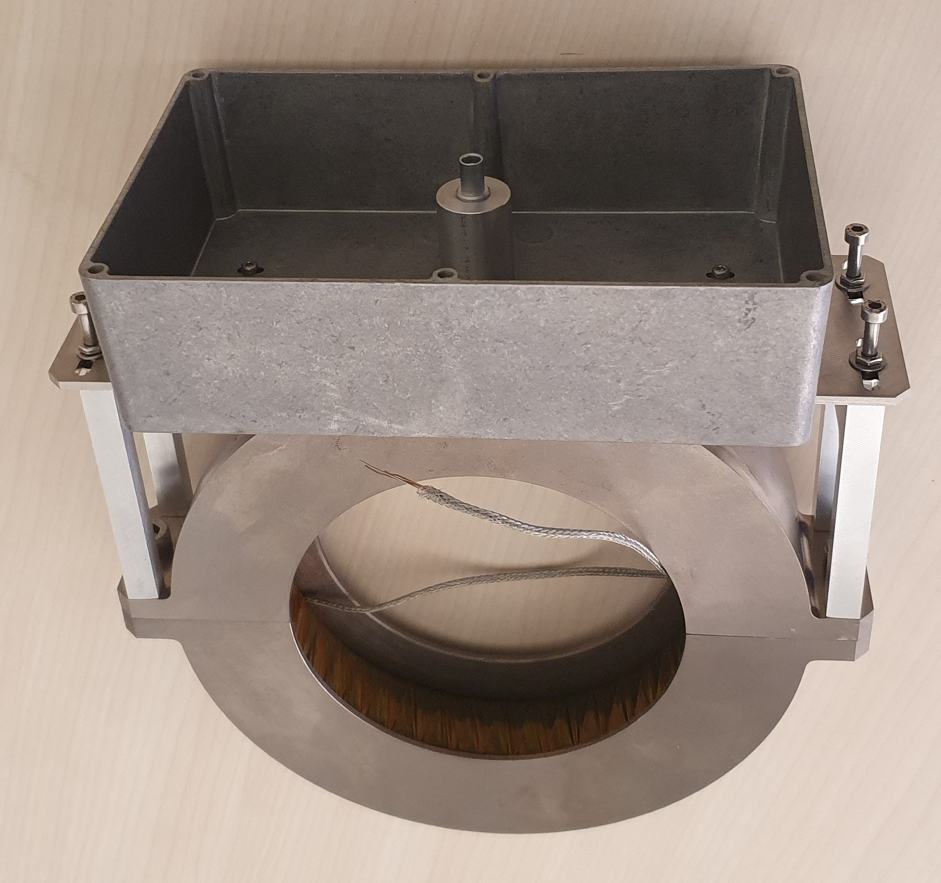
Beam diagnostics – intensity measurements
Low intensity measurement (ACCT)
for HEBT-NFS
for HEBT-S3 (second step)
Performances :
(for 1s integration and 100 Hz beam chopping frequency)
Today: 1 µA
Target: <100 nA
Status: ongoing development
characterization of a new in-flange ACCT prototype in 2022
1st measurement on the
prototype => definition
of the electronics
In flange design
In flange ACCT prototype
New current transformer
Court. S. Leloir & Ch. Jamet
GANIL Community Meeting 2022 – Caen – P.-E. Bernaudin
6

Slide 7
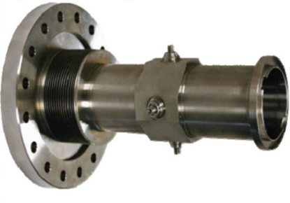
Beam diagnostics – BPM
BPM are the workhorse of the beam diagnostics in the
LINAC. Work is going on to improve performances:
  Precision enhancement for position, ellipticity &
  phase measurements (intended for low beam currents)
  FPGA software optimization to increase resolution at low
  beam currents
With the Controls group:
  Development of a BPM GUI dedicated for operation planned
  Program optimization and modifications to subtract RF disturbances planned
With the RF team:
  RF disturbances investigation ongoing
  Reliability enhancement of the phase reference system (BPM and RF cavities) ongoing
With the RF & Beam Dynamics teams:
  Virtual accelerator: for any beam, predicts cavities phases to be applied & BPM phases that should be measured idea
Court. Ch. Jamet
GANIL Community Meeting 2022 – Caen – P.-E. Bernaudin
7

Slide 8

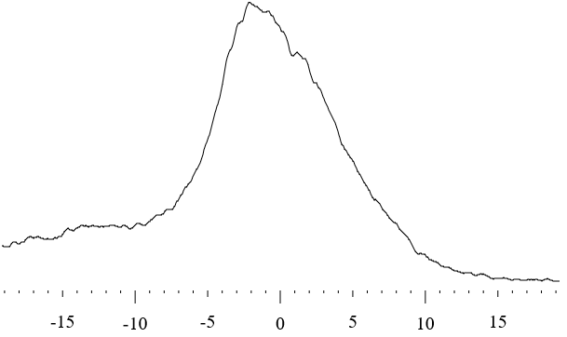
Beam diagnostics – LBE2 non interceptive profilers
In-beam lifetime of standard wire profilers in deuterons low energy beam line : 10 s at 5 mA!
Proposed solution: non interceptive profilers: Fluorescence Profile Monitors
Pressure of 10⁻⁵ to 10⁻⁶ mbar -> interaction of beam with residual gas produces fluorescence -> visualization and treatment using a camera
Status: ongoing
2021: Tested, proof of principle validated
2022: Operational tests on one horizontal profiler
2023: Installation of vertical profiler
2024: Installation of last two profilers
Camera real-time picture
Profile reconstruction
(6 s acquisition time)
Court. S. Leloir
GANIL Community Meeting 2022 – Caen – P.-E. Bernaudin
8

Slide 9
Beam diagnostics – Other activities
Emittancemeters planned
Current measurement and data acquisition for low beam intensities (S3 and NewGain)
Development of an emittancemeter GUI dedicated for operation
Beam Extension Monitors planned
Controls and GUI optimization
Beam Loss Monitors ongoing
Upgrading of FPGA sotware to enable several functions
Fast acquisition system (with controls team) planned
Simultaneous digitalization of all 30 current signals (today: only 2)
Automation of peak and mean intensities computation
Connection to Interlock system for machine protection (by example: interceptive profiler protection)
NewGain project diagnostic integration
Emittancemeter
Court. Ch. Jamet
GANIL Community Meeting 2022 – Caen – P.-E. Bernaudin
9

Slide 10
RF system developments
GANIL Community Meeting 2022 – Caen – P.-E. Bernaudin
10

Slide 11
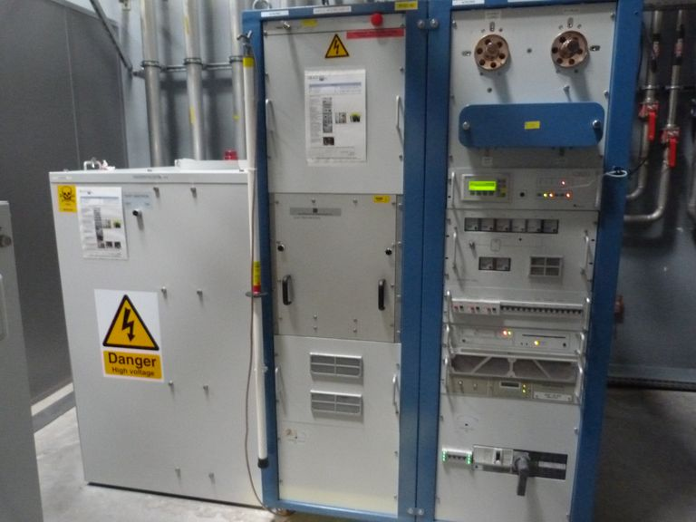
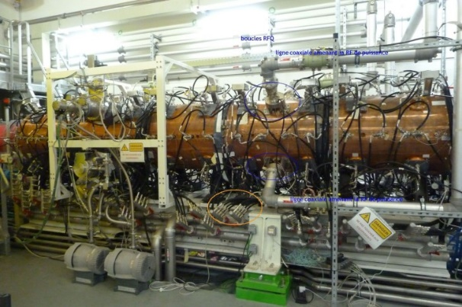
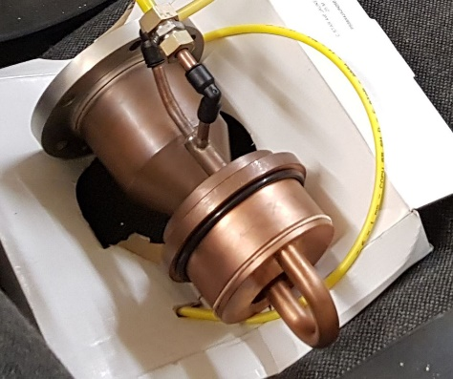
RFQ and its power sources
RFQ reliability at maximum voltage (for
heavy ions) may require improvement of
the power amplifiers
  High voltage improvement and polarization
  (procurements ongoing)
  Fast protection (study planned)
  Filament heating (test early 2023)
  New pre-amplifiers (planned 2024/25)
  Dedicated machine studies planned in 2022
Various strategic procurements (circulators,
power couplers…) either planned or ongoing
RFQ amplifiers
RFQ power coupler
Court. M.-H Stodel
GANIL Community Meeting 2022 – Caen – P.-E. Bernaudin
11

Slide 12
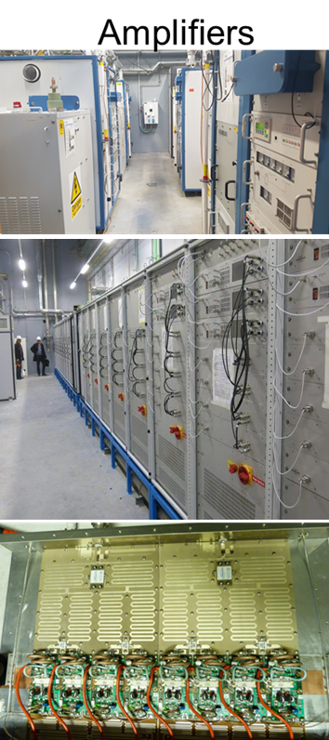
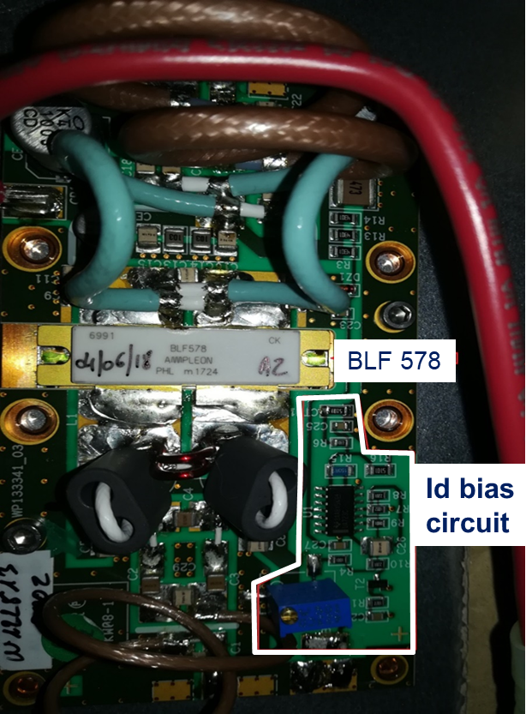
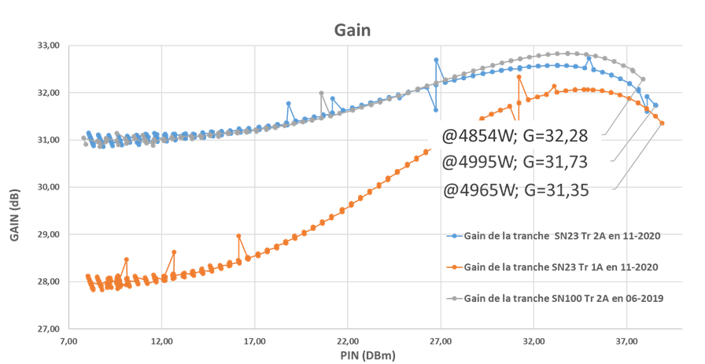
LINAC SC cavities & RF power sources
Issues & actions
Transistors’ interlocks trigger rate => Transistors cooling optimization Prototype test ongoing
Components aging monitoring (maintenance optimization) => upgrade the monitoring software studies ongoing
Components obsolescence studies ongoing
  control unit
  power transistors (2024)
  CMA cold tuning systems upgrade
626 RF transistors
Court. M.-H Stodel
GANIL Community Meeting 2022 – Caen – P.-E. Bernaudin
12

Slide 13
Focus on the superconducting cryomodules
GANIL Community Meeting 2022 – Caen – P.-E. Bernaudin
13

Slide 14
SC cryomodules – strategy
SC cavities are highly sensitive to pollution
SPIRAL2 SC linac is highly modular: short and relatively cheap cryomodules
To take advantage of this modularity, spare cryomodules should be procured:
  “Fast” replacement (~10 days) in case of major failure
  Preventive maintenance in case of performance loss (e.g. CMA11, CMB01)
  Preparation and test activities during operation => hidden time
  Priority for CMA for beam dynamics consideration
This strategy requires a cavities/cryomodule cryogenic test stand
  Qualification of bare new/refurbished SC cavities
  Qualification of new or refurbished cryomodules before installation in LINAC
In parallel: Plasma processing development to cure cavities in situ R&D with Irfu & IJC Lab
GANIL Community Meeting 2022 – Caen – P.-E. Bernaudin
14

Slide 15
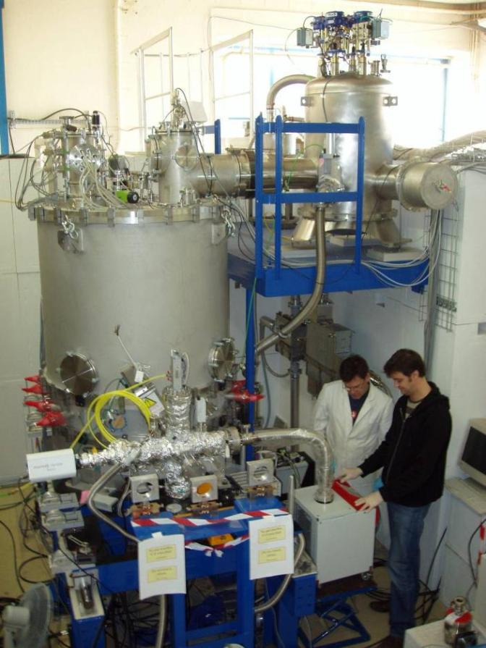
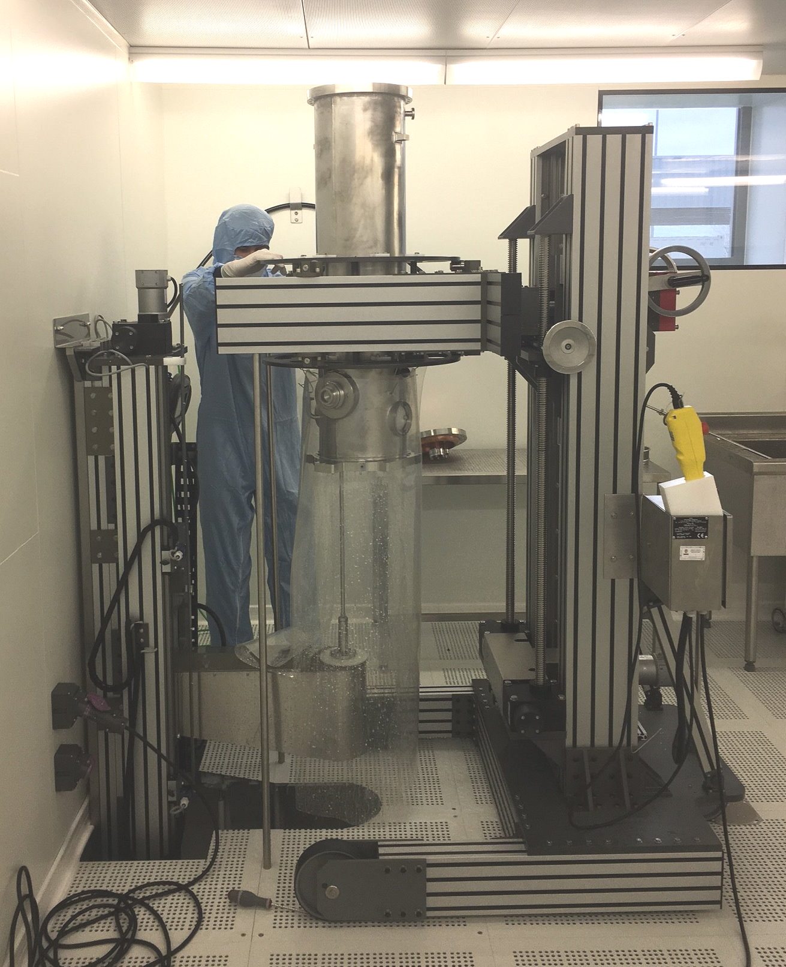
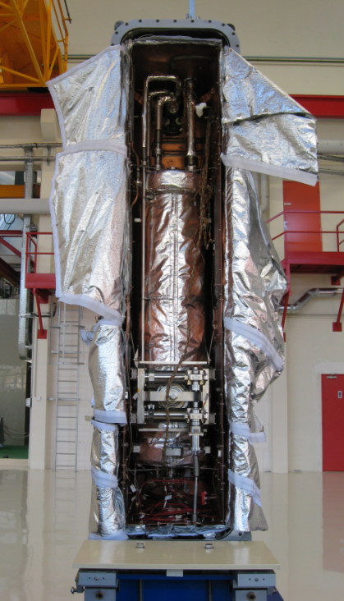
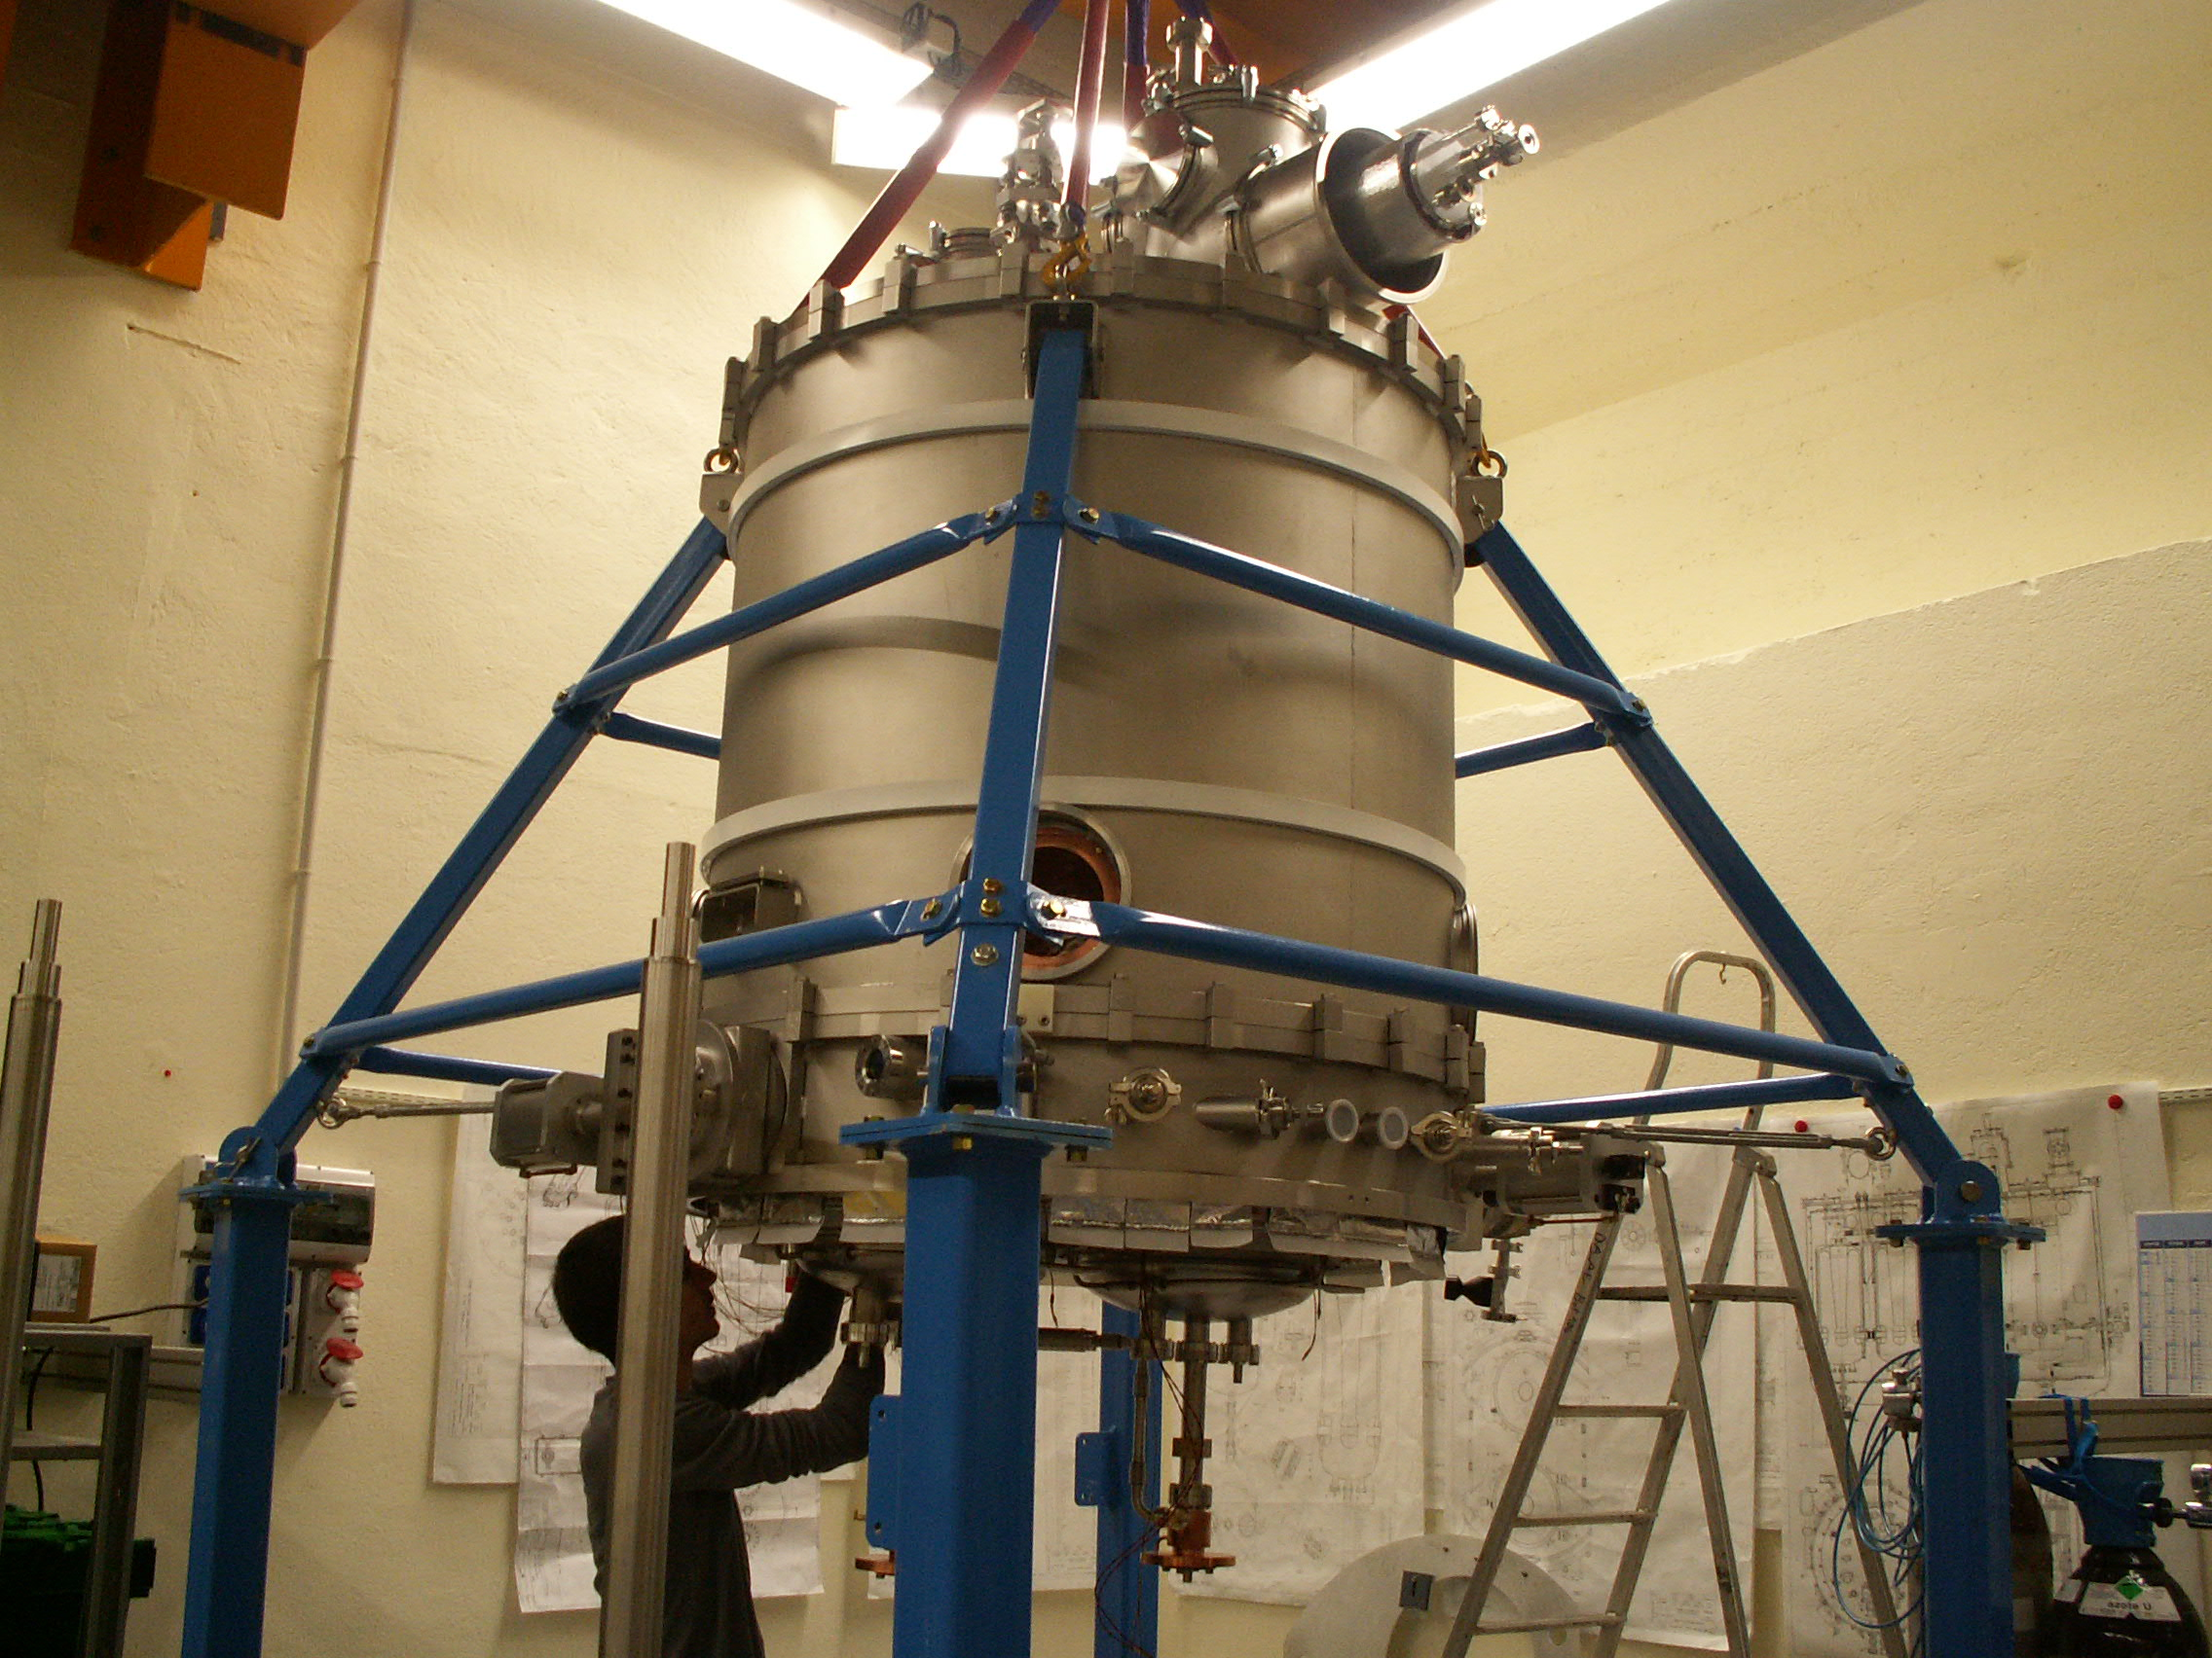
SC cryomodules – status
SC cryomodule test stand construction
  Budget: 1 M€, 1.5 years, 20 men.months
  Status: postponed, awaiting budget and manpower
Building a spare low-beta cryomodule
  Budget: 1 M€, >2 years, 20 men.months
  Status: development plan
Building a spare high-beta cryomodule
  Budget: 1.5 M€, >2 years, 20 men.months
  Status: idea
Former IPN Orsay SPIRAL2 test stand
SC cavity treatment in GANIL clean room
CMB assembly in IPN Orsay
GANIL Community Meeting 2022 – Caen – P.-E. Bernaudin
CMA assembly in CEA Saclay
15

Slide 16
Controls developments
GANIL Community Meeting 2022 – Caen – P.-E. Bernaudin
16

Slide 17
Controls
New application softwares for beam tuning
  “Delta Q/M tuning”: accelerator tuning for ions intensities too low for the BPM planned
  “cavities with reference tuning”: faster cavities tuning method based on a different ion reference planned
  “crossed method buncher tuning”: alternate tuning method for bunchers with enhanced precision ongoing
  BPM energy measurements : phase differences between two BPM are used to measure the beam energy planned
Optimization of existing applications
(beam switching, beam parameters management,
RF cavities operation…) ongoing
Cryogenic TAO detection ongoing
Exploration of AI for fault detection,
beam stirring,… planned
Buncher tuning application
GANIL Community Meeting 2022 – Caen – P.-E. Bernaudin
17

Slide 18
Controls - programmable logic controllers
PLC: towards standardization for maintainability increase
  Replacement of non standard PLCs (refrigeration) development plan
    Low competence in GANIL on Siemens PX PLC
    PX PLC are sensitive to network issues
    In case of problem, reliance on external resources -> low reactivity
    A very sensitive utility
    Upgrade to high availability PLCs: 80 k€ budget, 8 months program, including 5 month unavailability of refrigeration station
  Upgrade of programs to last standards (Siemens) ongoing
  Replacement of unsupported UI by Siemens standards ongoing
Court. N. Simon-Bauduin
GANIL Community Meeting 2022 – Caen – P.-E. Bernaudin
18

Slide 19
And more…
Other teams are also working in order to upgrade and optimize their systems to improve their reliability:
  Vacuum
  Cryogenics
  Bunch selectors
  Machine protection system
  Safety actuators
  …
GANIL Community Meeting 2022 – Caen – P.-E. Bernaudin
19

Slide 20
Conclusion
GANIL Community Meeting 2022 – Caen – P.-E. Bernaudin
20

Slide 21
Conclusion
All GANIL technical teams are working on improving the reliability & maintainability of their systems
Optimizing operation & beam tuning (through optimized GUIs and controls) is an ongoing progress
Minimizing beam downtime on SPIRAL2 is a major priority for GANIL
In parallel, the diagnostic team is focused on the low intensity beams
Limited resources: priorities to be set
GANIL Community Meeting 2022 – Caen – P.-E. Bernaudin
21

Slide 22
Thank you for your attention.
GANIL Community Meeting 2022 – Caen – P.-E. Bernaudin
22

