Slide 1

NEWGAIN Project - Scientific Goals
I. Stefan
IJCLab
NEWGAIN scientific coordinator
I. Stefan GCM 2022

Slide 2
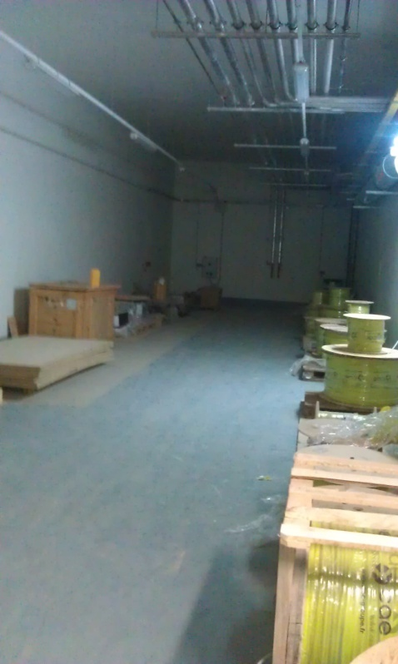
NEWGAIN project
Existing
Current project
Main User
I. Stefan GCM 2022

Slide 3

















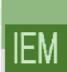
NEWGAIN Project - Scientific Goals: Relevant Beams & Intensities
Estimated in 2021
Important: RFQ dimensioned for 15 puA ⁴⁸Ca and 10 puA for ²³⁸U
Ions | Intensity (pµA) Phoenix V3 RFQ A/Q≤3 | Intensity (pµA) Phoenix V3 RFQ A/Q≤7 | Intensity (pµA) SC Ion Source RFQ A/Q≤7 | Intensity (pµA) SC Ion Source RFQ A/Q≤6
¹⁸O | 80 | * | 375 | 375
¹⁹F | >15 | >40 | >40 | >40
³⁶Ar | 16 | 70 | 45 | 45
⁴⁰Ar | 3.6 | 70 | 45 | 45
³⁶S | 2.3 | * | * | *
⁴⁰Ca | 2.9 | 10 | 20 | 20
⁴⁸Ca | 1.2 | 10 | 20 | 20
⁵⁸Ni | 1.1 | 4 | 8 | 8
⁸⁴Kr | 0.1 | 10 | 20 | 20
¹³⁹Xe | 0.001 | 7 | >10 | >10
²³⁸U | <<0.001 | 0.1 | 6 | 0.5
Measured
Estimated
* -> no estimation
Collaboration S3-LEB-SIRIUS-DESIR
I. Stefan GCM 2022

Slide 4
NEWGAIN Project - Scientific Goals: Relevant Beams & Intensities
Estimated in 2021
Important: RFQ dimensioned for 15 puA ⁴⁸Ca and 10 puA for ²³⁸U
NEWGAIN
Consolidation and reinforcement of the S3, LEB & DESIR A/Q=3 physics program.
Relevant beams:
^{12,13,14}C, ^{16,17,18}O, ^{20,21,22}Ne, ²³Na, ^{24,25,26}Mg, ²⁷Al, ^{28,29,30}Si, ^{32,34}S, ^{35,37}Cl, ^{38,40}Ar, ^{38,39,40}K, ^{40,42,43,44,46,48}Ca, ^{46,47,48,49,50}Ti, ⁵¹V, ^{50,52,53,54}Cr, ⁵⁵Mn, ^{54,56,57,58}Fe, ⁵⁹Co, ^{58,60,61,62,64}Ni, ^{63,65}Cu, ^{64,66,67,68,70}Zn, ^{74,76}Ge, ^{78,86}Kr, ^{84,86}Sr, ⁹⁰Zr, ⁹²Mo
Ions | Intensity (pµA) Phoenix V3 RFQ A/Q≤3 | Intensity (pµA) Phoenix V3 RFQ A/Q≤7 | Intensity (pµA) SC Ion Source RFQ A/Q≤7 | Intensity (pµA) SC Ion Source RFQ A/Q≤6
¹⁸O | 80 | * | 375 | 375
¹⁹F | >15 | >40 | >40 | >40
³⁶Ar | 16 | 70 | 45 | 45
⁴⁰Ar | 3.6 | 70 | 45 | 45
³⁶S | 2.3 | * | * | *
⁴⁰Ca | 2.9 | 10 | 20 | 20
⁴⁸Ca | 1.2 | 10 | 20 | 20
⁵⁸Ni | 1.1 | 4 | 8 | 8
⁸⁴Kr | 0.1 | 10 | 20 | 20
¹³⁹Xe | 0.001 | 7 | >10 | >10
²³⁸U | <<0.001 | 0.1 | 6 | 0.5
Measured
Estimated
* -> no estimation
Collaboration S3-LEB-SIRIUS-DESIR
I. Stefan GCM 2022

Slide 5
NEWGAIN Project - Scientific Goals: Relevant Beams & Intensities
Estimated in 2021
Important: RFQ dimensioned for 15 puA ⁴⁸Ca and 10 puA for ²³⁸U
NEWGAIN
Consolidation and reinforcement of the S3, LEB & DESIR A/Q=3 physics program.
Relevant beams:
^{12,13,14}C, ^{16,17,18}O, ^{20,21,22}Ne, ²³Na, ^{24,25,26}Mg, ²⁷Al, ^{28,29,30}Si, ^{32,34}S, ^{35,37}Cl, ^{38,40}Ar, ^{38,39,40}K, ^{40,42,43,44,46,48}Ca, ^{46,47,48,49,50}Ti, ⁵¹V, ^{50,52,53,54}Cr, ⁵⁵Mn, ^{54,56,57,58}Fe, ⁵⁹Co, ^{58,60,61,62,64}Ni, ^{63,65}Cu, ^{64,66,67,68,70}Zn, ^{74,76}Ge, ^{78,86}Kr, ^{84,86}Sr, ⁹⁰Zr, ⁹²Mo
New opportunities given by the heaviest of beams
Not part of S3 physics program. S3 not well adapted
Relevant beams:
¹³⁶Xe, ¹⁹⁷Au,²⁰⁸Pb,Bi,Th,²³⁸U
Ions | Intensity (pµA) Phoenix V3 RFQ A/Q≤3 | Intensity (pµA) Phoenix V3 RFQ A/Q≤7 | Intensity (pµA) SC Ion Source RFQ A/Q≤7 | Intensity (pµA) SC Ion Source RFQ A/Q≤6
¹⁸O | 80 | * | 375 | 375
¹⁹F | >15 | >40 | >40 | >40
³⁶Ar | 16 | 70 | 45 | 45
⁴⁰Ar | 3.6 | 70 | 45 | 45
³⁶S | 2.3 | * | * | *
⁴⁰Ca | 2.9 | 10 | 20 | 20
⁴⁸Ca | 1.2 | 10 | 20 | 20
⁵⁸Ni | 1.1 | 4 | 8 | 8
⁸⁴Kr | 0.1 | 10 | 20 | 20
¹³⁹Xe | 0.001 | 7 | >10 | >10
²³⁸U | <<0.001 | 0.1 | 6 | 0.5
Measured
Estimated
* -> no estimation
Incipient phase
A/Q=3 (existant): E<=14.5 MeV/A
A/Q=7 : E<=7 MeV/A
I. Stefan GCM 2022

Slide 6
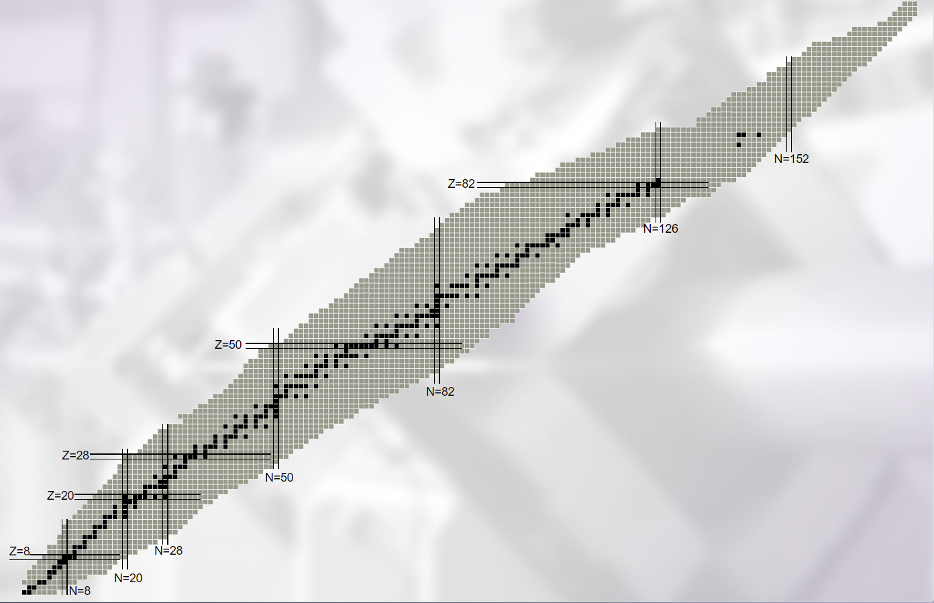
NEWGAIN Project - Scientific Goals: Existing Program
All this will be done using: S3, S3-LEB, DESIR
Fusion – evaporation: Neutron-deficient products
I. Stefan GCM 2022

Slide 7
NEWGAIN Project - Scientific Goals: Existing Program
All this will be done using: S3, S3-LEB, DESIR
Fusion – evaporation: Neutron-deficient products
Discovery frontier
How many neutrons and protons can we put
into a nucleus?
Precision frontier
High precision measurements for masses and
similar properties
Interdisciplinary research - FISIC Project
study collisions fast ions vs slow ions
Solid state physics and medical applications
Material characterisation ( beta-NMR,
Mössbauer spectroscopy, and emission
channelling techniques)
I. Stefan GCM 2022

Slide 8
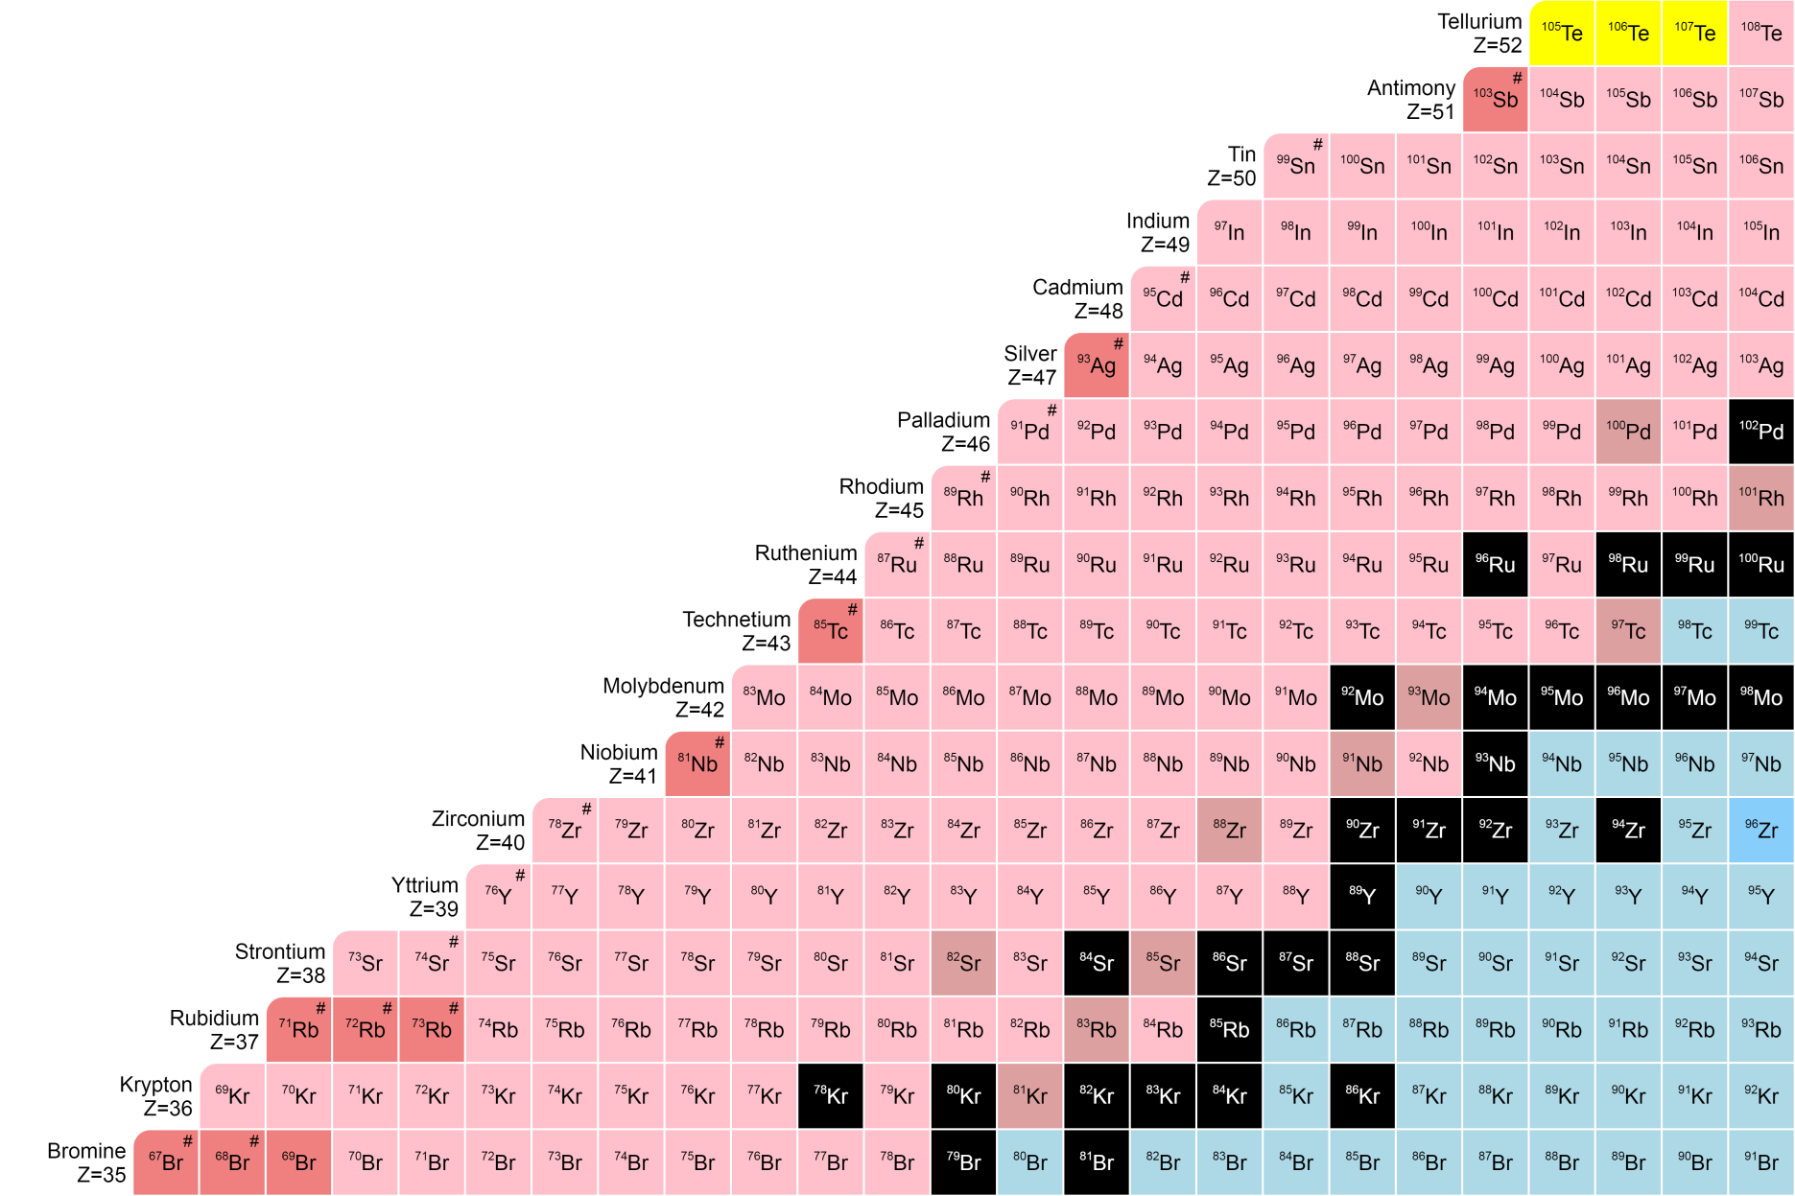
NEWGAIN Project - Scientific Goals: N=Z physics
N = Z
LOI
S3 workshop (June 18)
Known masses
I. Stefan GCM 2022

Slide 9
NEWGAIN Project - Scientific Goals: N=Z physics
N = Z
LOI
S3 workshop (June 18)
Known masses
A/Q = 3
I. Stefan GCM 2022

Slide 10
NEWGAIN Project - Scientific Goals: N=Z physics
Access to nuclei unavailable for other facilities
N = Z
LOI
S3 workshop (June 18)
Known masses
A/Q = 3
A/Q = 7 (NEWGAIN)
I. Stefan GCM 2022

Slide 11
NEWGAIN Project - Scientific Goals: Implications for N=Z physics
Comparison with FRIB (USA)
No change between A/Q=6 and A/Q=7
Takes into account :
Production cross-section
Transmission/efficiency to S3 – LEB (dependent on the T_{1/2})
Rates (pps) | S3 LEB (A/Q=3) | S3 LEB (A/Q=7) | FRIB1 | FRIB2 | FRIB Final
¹⁰⁰Sn | 7 | 34 | 0.05 | 0.2 | 4
¹⁰¹Sn | 170 | 850 | 3 | 10 | 161
⁹⁷In | 0.2 | 2.6 | 0 | 0 | 0
⁹⁸In | 4 | 11 | 0.02 | 0.09 | 4
⁹⁹In | 80 | 800 | 2.7 | 13 | 316
¹⁰⁰In | 740 | 7400 | 231 | 1150 | 18400
⁹⁸Cd | 3600 | 18000 | 505 | 2520 | 105000
⁹⁷Cd | 19 | 95 | 6.4 | 32 | 2030
⁹⁶Cd | 3 | 15 | 0.24 | 1.2 | 89
⁹⁵Cd | 0.4 | 2 | 0.004 | 0.02 | 1.6
⁹⁴Ag | 136 | 680 | 0.04 | 0.2 | 20
⁹⁵Ag | 870 | 4350 | 30 | 152 | 14700
⁹¹Pd | 81 | 405 | 0.02 | 0.12 | 27
⁹²Pd | 810 | 4050 | 1.7 | 8 | 1870
⁹⁰Rh | 210 | 1050 | 0.02 | 0.09 | 52
S3 LEB rates:
https://www.ganil-spiral2.eu/scientists/ganil-spiral-2-facilities/available-beams/
FRIB Estimated Rates Version 2.01: https://groups.nscl.msu.edu/frib/rates/fribrates.html
N=Z nucleus Highest intensity
L. Caceres 2021
Highly competitive - Leadership
I. Stefan GCM 2022

Slide 12
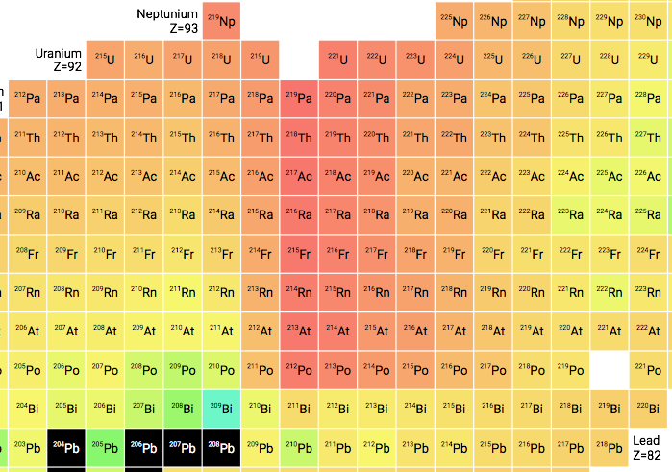
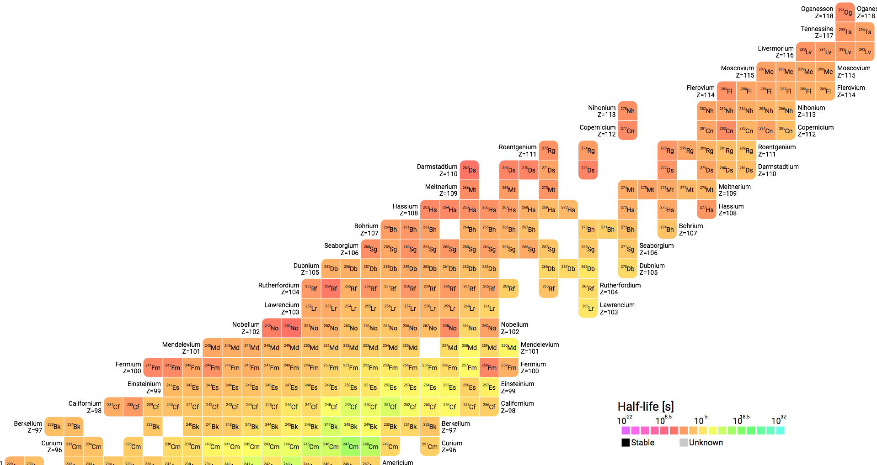
SHE Physics Cases
NEWGAIN Project - Scientific Goals: SHE physics
Map nuclear structure
Bridge the gap between hot and cold fusion
A/Q=3
A/Q=7 NEWGAIN
Probe the limits of stability
A/Q=3
A/Q=7 NEWGAIN
SHE synthesis
Opportunity to produce a new element
A/Q=7 NEWGAIN
N=162
²⁷⁶Cn
²⁷⁶Ds
N=152
²⁷²Ds
N=126
²⁷²Hs
S3 unique advantage => dM/M<1/300
²⁵⁶Sg
²⁵⁷Sg
²⁶⁸Sg
²⁵²Rf
12 Letters of intent for S3
1 Letter of intent for DESIR
To be updated in 2022
Z=100
people.physics.anu.edu.au/
I. Stefan GCM 2022
Notes:
Flash setups here

Slide 13

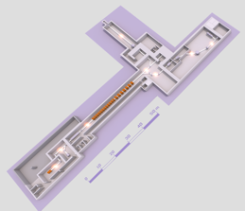

NEWGAIN Project - Scientific Goals: Implications for SHE physics
Comparison between different installations relevant to SHE studies
Beam intensities puA 100% enriched | SPIRAL2 GANIL, Caen |  | SHE factory FLNR, Dubna** | RIKEN Nishina Center Wako (Tokyo) |  | GSI Darmstadt
 | LINAG A/q≤3 Phoenix v3 | NEWGAIN* A/q≤7 SC source | DC-280 | RILAC | RRC (RILAC(2) as injector) | UNILAC***
¹⁸O | 80 | 300 | 16 | 10 | - | 1
⁴⁰Ar | 16 | 38 | 10 | 10 | 1 | 8
³⁶S | 23 | 30 | **** | - | - | -
⁴⁰Ca | 2.9 | 16 | **** | - | - | -
⁴⁸Ca | 1.2 | 16 | 10 | 3 | 0.3 | 4
⁵⁸Ni | 1.1 | 6.4 | **** | **** | **** | 2.2
⁸⁶Kr | 0.1 | 16 | **** | 10 | **** | 0.2
¹³⁶Xe | 0.001 | >10 | 16 | 10 | 0.3 | 1
²³⁸U | <<0.001 | 4.8 | 0.008 | 0.2 | 0.5 | 0.06^{i}
* 80% total transmission assumed ** http://flerovlab.jinr.ru/index.php/2017/03/23/she-factory/ *** for the cw-linac project with the assumption of a 50% total transmission, priv. comm. W. Barth et al., GSI **** beams not delivered i VARIS ion source, 80% Alvarez-transmission, mode: 2 Hz/0.1 ms, priv. com. W. Barth et al., GSI - intensities not provided Iiiii
A/Q=7
LINAG
A/Q=1 and 3
DC-280
RILAC
RRC
+ cw-LINAC
UNILAC
Highest intensity
Estimated in 2021
I. Stefan GCM 2022

Slide 14
NEWGAIN Project - Scientific Goals: Opportunities
All this will be done using: S3, S3-LEB, DESIR
Fusion – evaporation: Neutron-deficient products
I. Stefan GCM 2022

Slide 15
NEWGAIN Project - Scientific Goals: Opportunities
All this will be done using: S3, S3-LEB, DESIR
Fusion – evaporation: Neutron-deficient products
Opportunities
Multi-nucleon transfer + fusion-fission:
neutron-rich nuclei
- heavy beams (Pb, U)
-> incipient phase
-A new target-ion source based on multinucleon transfer reactions and fusion-fission reactions
-An electron-radioactive ion collider
-The reacceleration of radioactive ion beams, up to Fermi energies by a dedicated accelerator
Incipient phase!
I. Stefan GCM 2022

Slide 16
NEWGAIN Project - Scientific Goals: Summary
Opportunity to gain leadership position - S3, S3 LEB, DESIR
  Neutron deficient nuclei (N=Z nuclei)
  SHE studies
  Constraints: S3 target -> 10 puA ⁷⁰Zn @5 MeV/A
Heavy beams: opportunity to develop a new physics program using: MNT, Fusion-fission & Fission-Evaporation in inverse kinematics (very) incipient phase
Important:
Target development:
S3 - 10 puA ⁷⁰Zn @ 5 MeV/A
development of new target (gas?). Learn from other programs (KISS, JYFL, ANL)
New installations:
S3 not adapted for heavy beams (Pb, Bi, U)
NEWGAIN White Book
Detail the scientific program
Avaiable online: https://tel.archives-ouvertes.fr/IP2I/hal-03280595v1
I. Stefan GCM 2022

Slide 17

NEWGAIN Project : Summary
Three main axes of exchanges and discussions:
Accelerator, instrumentation and target development
Scientific program with S3 beams
New avenues with (very) heavy NEWGAIN beams
NEWGAIN White Book
Detail the scientific program
Avaiable online: https://tel.archives-ouvertes.fr/IP2I/hal-03280595v1
WORKSHOP Physics with Spiral2 Heavy Beams
Discuss the physics program and propose new ideas (12-16 December 2022 @GANIL)
I. Stefan GCM 2022

