Slide 1
Gas-cell for MNT demonstrator
October 18th 2022
Ch. Theisen

Slide 2
Disclaimer :
This is not a technical presentation of a gas-cell (I know very little about gas cells).
I will present the physics motivations and a very rough outline of the layout.

Slide 3
Production of very- and super-heavy nuclei
Fusion-evaporation reactions are almost exclusively used to produce the heaviest nuclei.
However, in the 1980s, an impressive number of studies were carried out with multinucleon transfer reactions.
mb
Hoffman et al., PRC 31 (1985) 1763
M. Schädel et al., PRL 48 (1982) 852
µb
^{40,48}Ca + ²⁴⁸Cm
→ large number of nuclei in one shot. Substantial cross section. On the right side of the chart

Slide 4
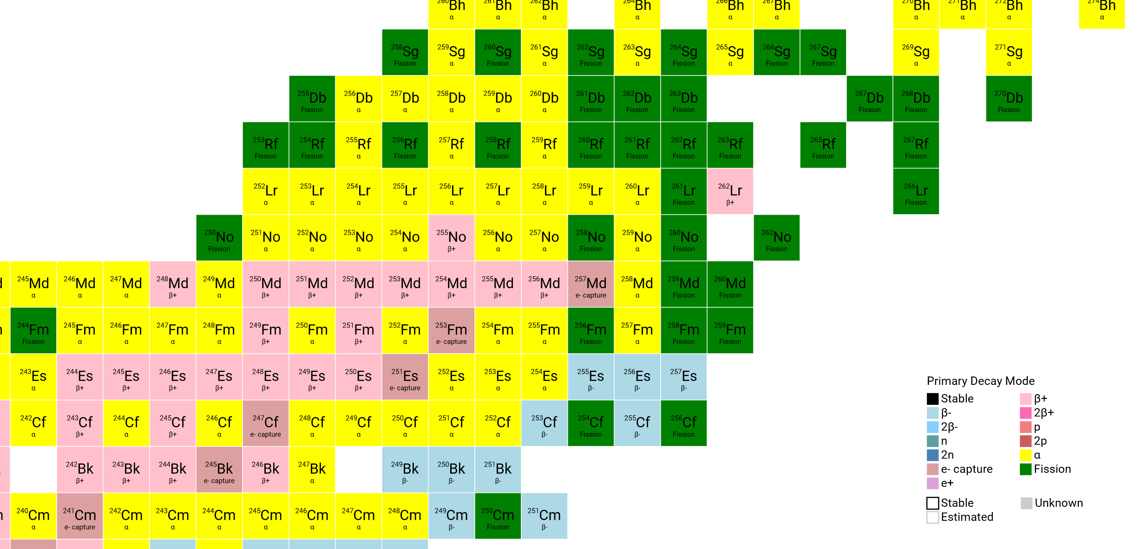

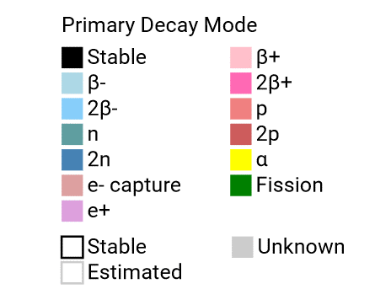
Example with ²⁴⁸Cm, ²⁵⁴Es targets
Limits using fusion-evaporation with ⁴⁸Ca beam
But : large angular and velocity dispersion. Only radiochemical techniques. Not adapted to spectroscopy

Slide 5
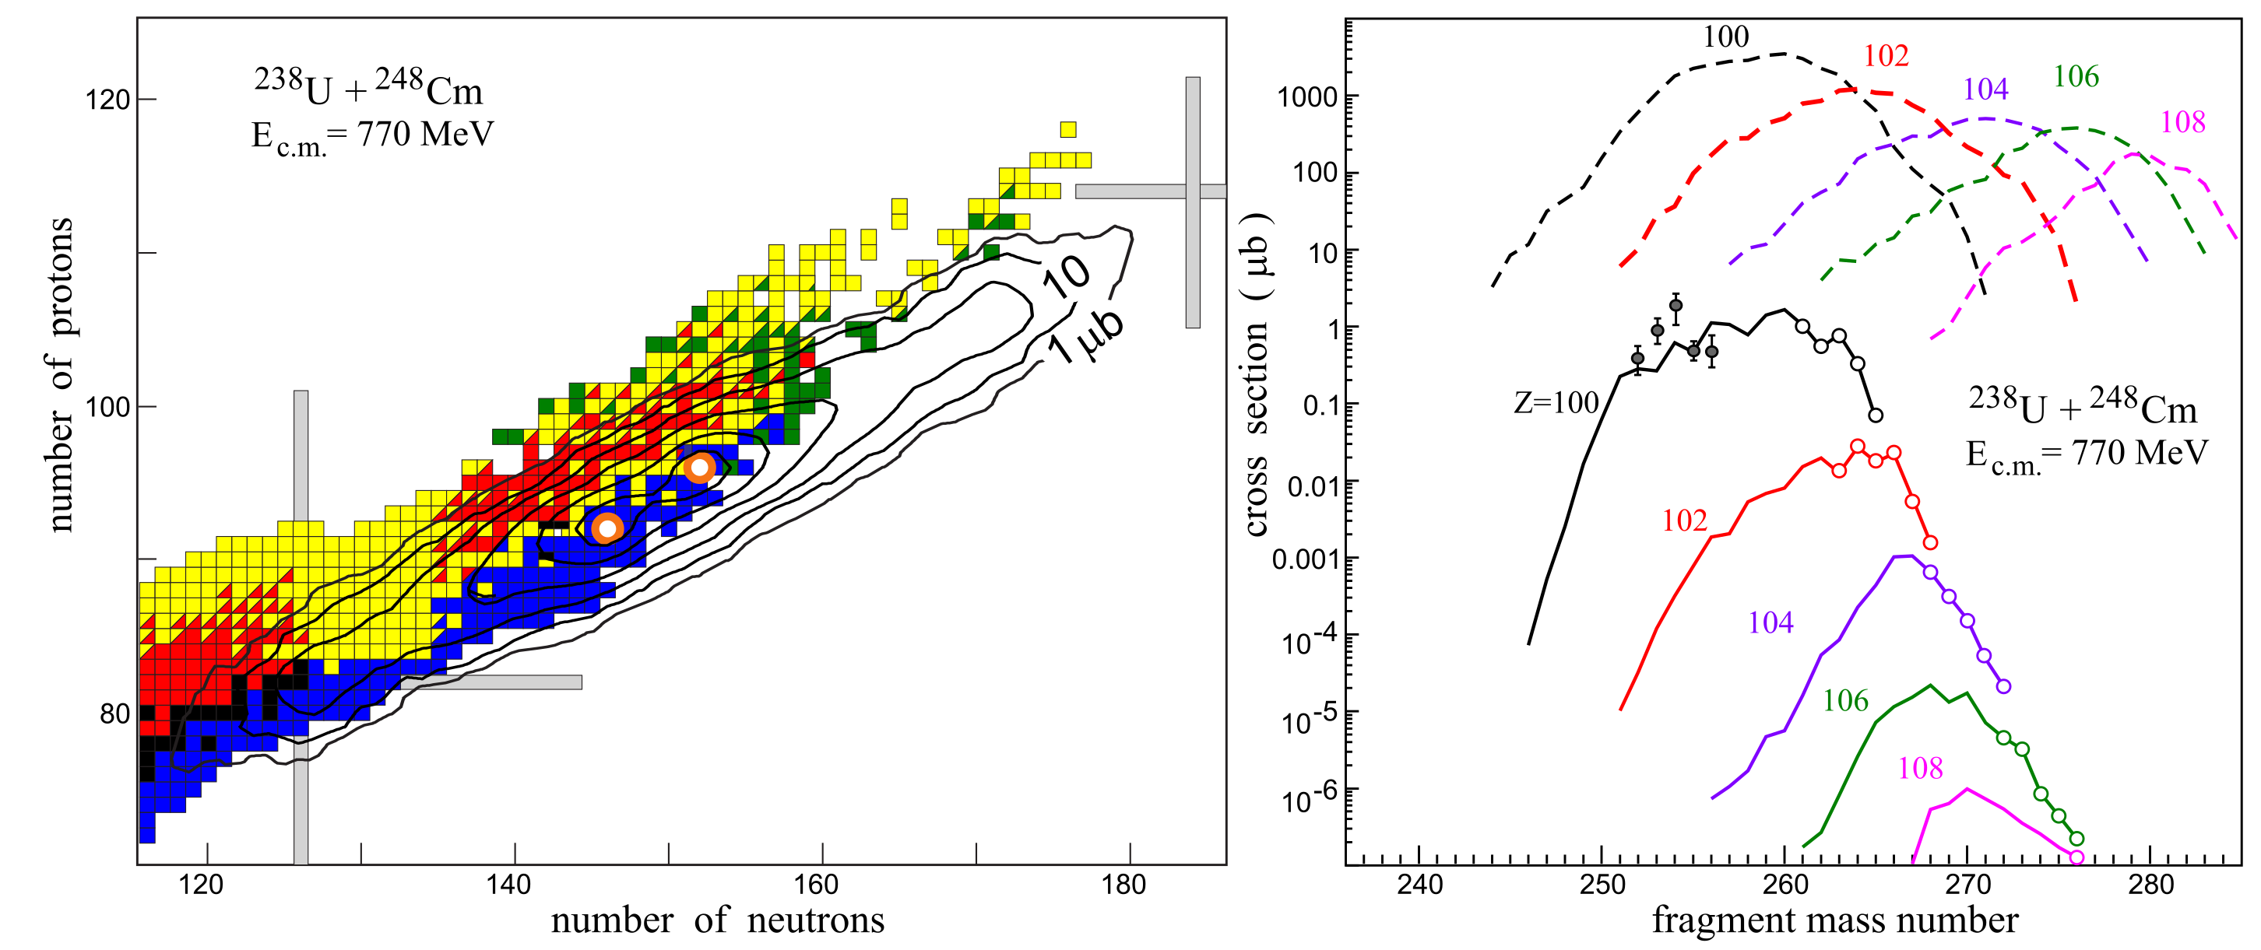
Zagrebaev, Karpov, Greiner
Experimental data
Unknown
isotopes
Role of shell structure in enhancing yields
Substantial production at zero degree

Slide 6
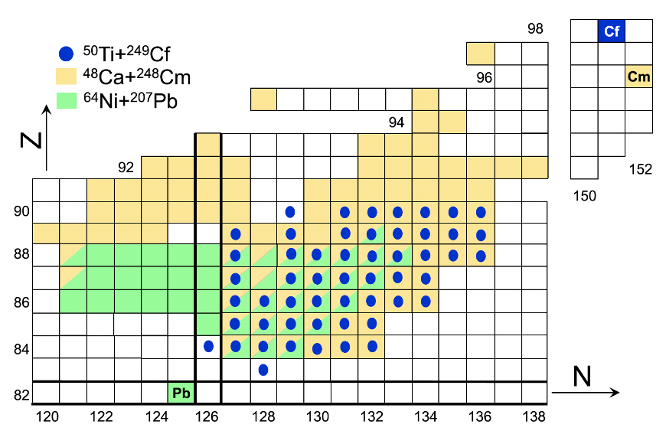
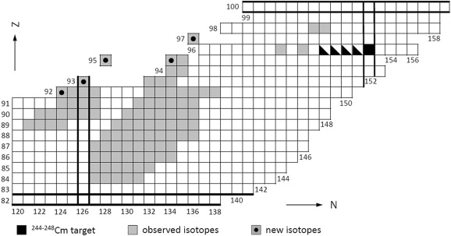
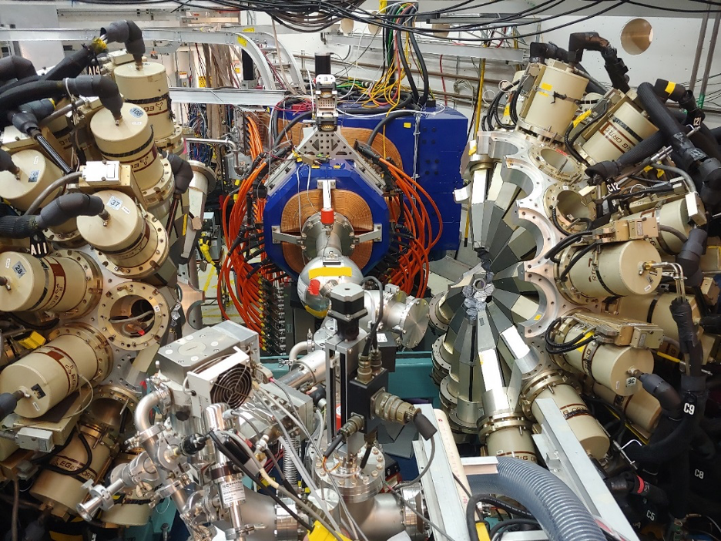
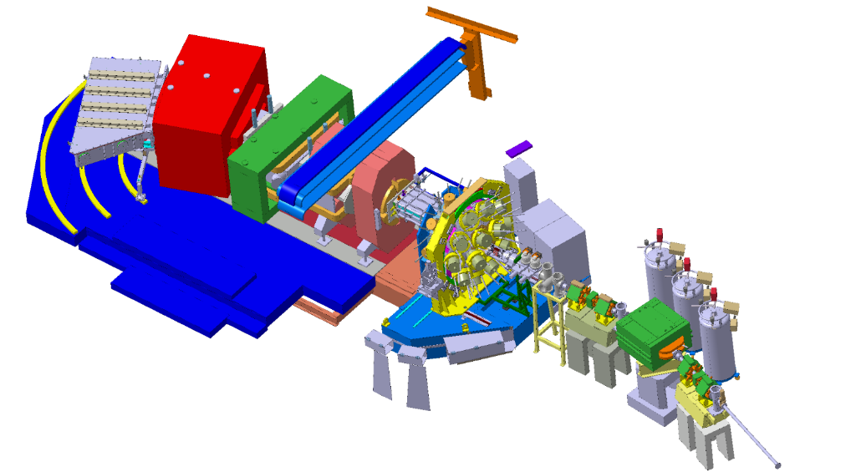
Recent steps towards spectroscopy
MNT at zero degree using SHIP
⁵⁰Ti+²⁴⁹Cf at TASCA, gas-filled separator
⁴⁸Ca+²⁴⁸Cm
Dejavara et al,, PLB 748 (2015) 199
A. Di Nitto et al.,
PLB 784 (2018) 199
¹³⁶Xe + ²³⁸U
AGFA + Gammasphere
B. Sulignano et al.
VAMOS-GFS ?
Notes:
It is very speculative to talk about vamos-gfs, but it could be an option, We made Brho calculation for vamos-gfs and also agfa. Simulations show that it should work How is another question. In any case, vamos-gfs, if it ever exists, will probably be the only gas separator in the world capable of operating at angles other than zero degrees.

Slide 7

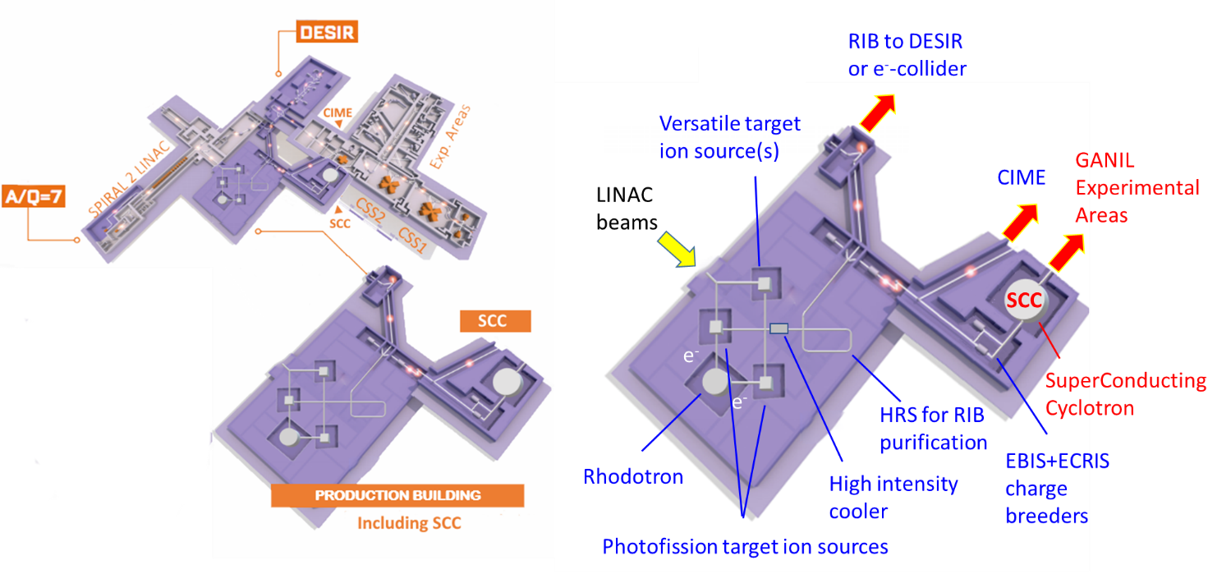
Ideas within the « Spiro » contribution to the future of Ganil
1 Benefit from ultra-high intense beams using A/Q = 7 injector to produce exotic actinide
2 Manipulate these ions
3 reaccelerate these ions
(did not exist yet)
https://indico.in2p3.fr/event/20534/
Notes:
newgain did not exist when we wrote our contribution. Now it is a reality that should start in a few years.

Slide 8
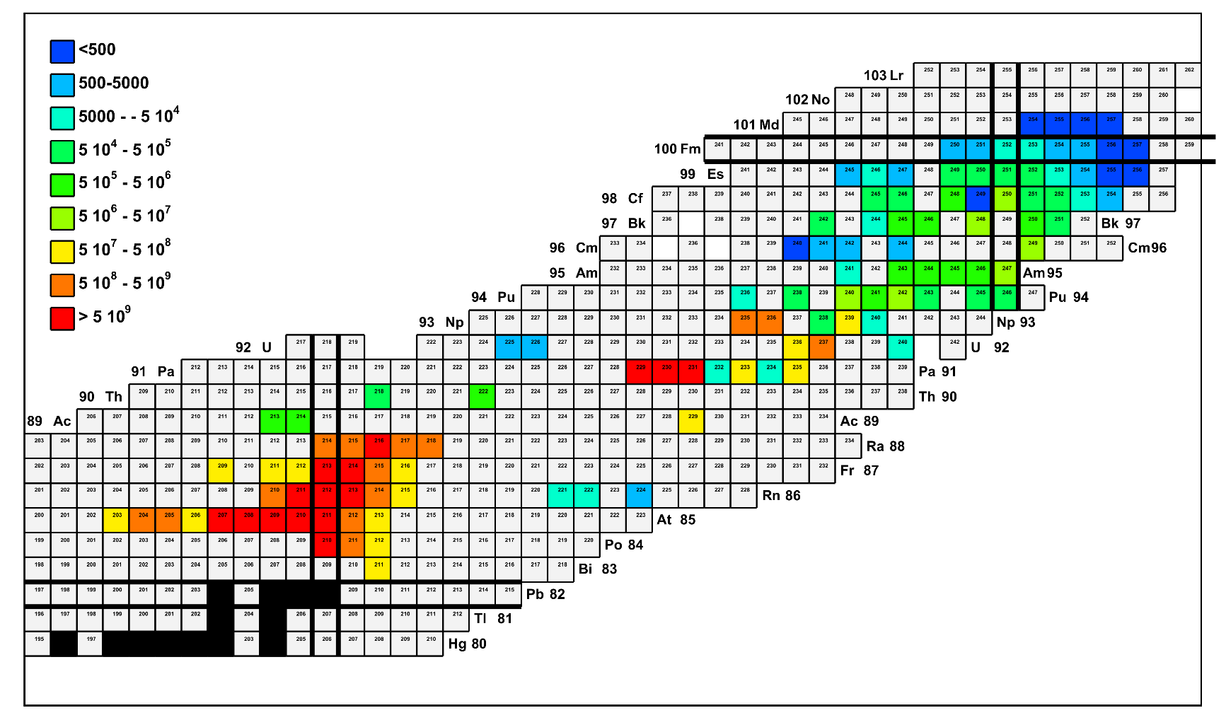
MNT and other reactions production rates
Fusion-evaporation
~ 3 10⁶
Fusion-evaporation
and incomplete fusion
p-induced
MNT ²⁴⁸Cm target
MNT ²³⁸U target
(produced but few
know cross-sections)
~ 6 10⁹
« Spiro » WG3 and Newgain White Book.
Notes:
Work made within WG 3 and the newgain white book.
This is just an example of what could be done with newgain and a target-ions source.
!!! Production in the target !!! Efficiency to extract and re-accelerate need to be included.
However that would be a unique facility wrolwide; Remember Isolde stops at Ra.

Slide 9
Physics cases
Shape and collectivity → Coulex
B(E2) up to Fm and possibly No
Medium to high spin spectroscopy
Spectroscopy using direct reactions
Speng et al., PRL 17 (1983) 1522
Yates et al. PRC 12 (1975) 442

Slide 10
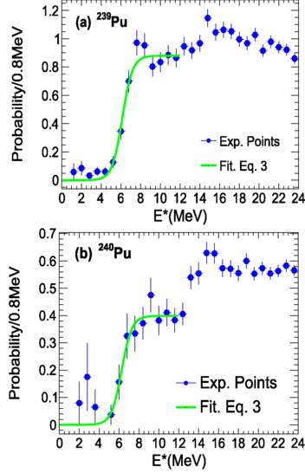
Fission
Fission barrier distribution
Kean et al. PR 100 (2019) 014611,
JAEA ¹⁸O + ²³⁷Np @ 162 MeV
C. Rodríguez-Tajes et al., PRC 89 (2014) 024614
²³⁸U @ 6.14 MeV/u + ¹²C VAMOS + SPIDER
Notes:
Inverse kinematics works !

Slide 11
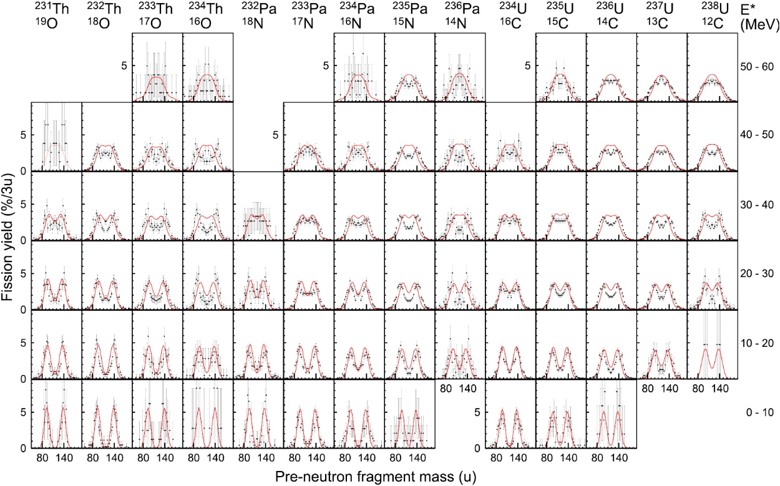
Fission
Fission fragments distribution
¹⁸O+²³²Th @ 157 MeV, JAEA
R. Léguillon et al., PLB 761 (2016) 125

Slide 12
First step : demontrator in S3 hall ?
« Spiro » report : deployment of SPIRAL2-Phase1: (full implementation in 2030).
« The committee also recommends a demonstrator gas cell for Multi Nucleon transfer reactions in the S3 hall ».

Slide 13
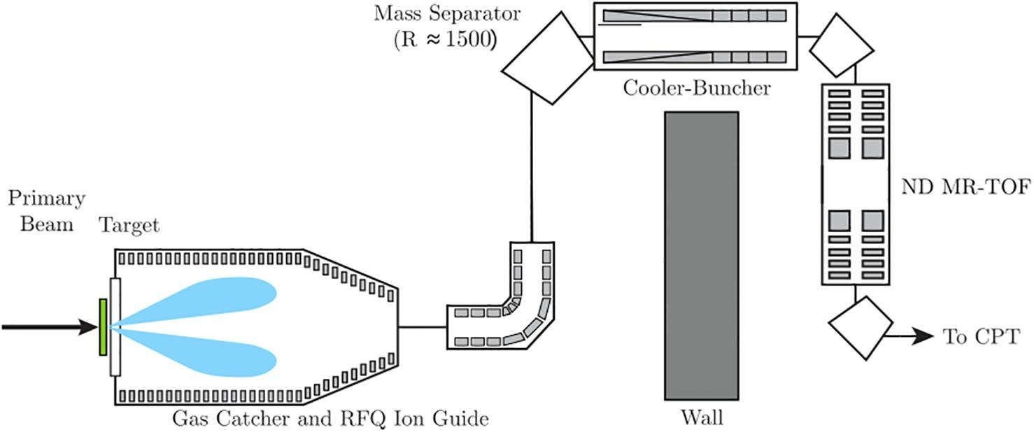
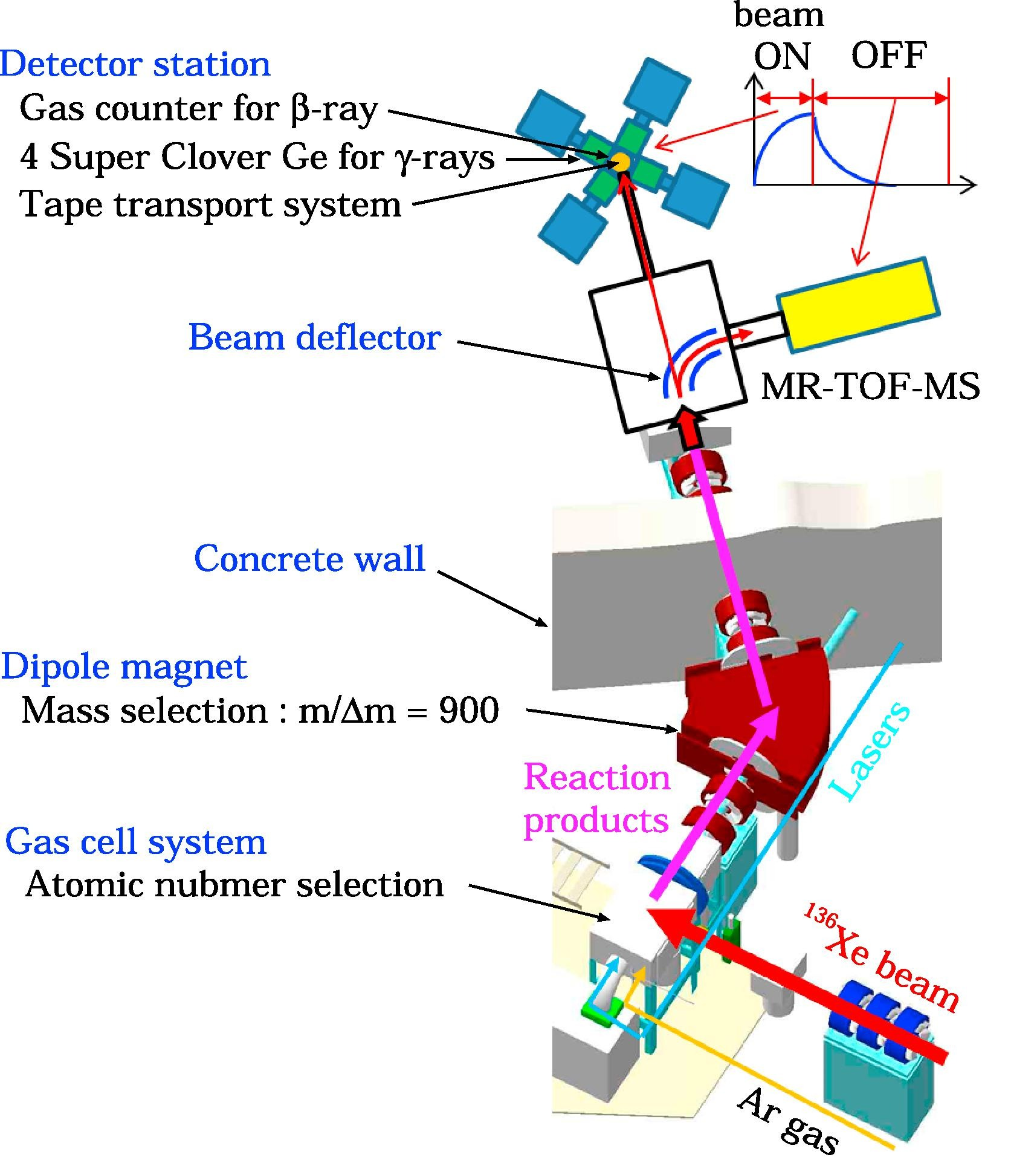
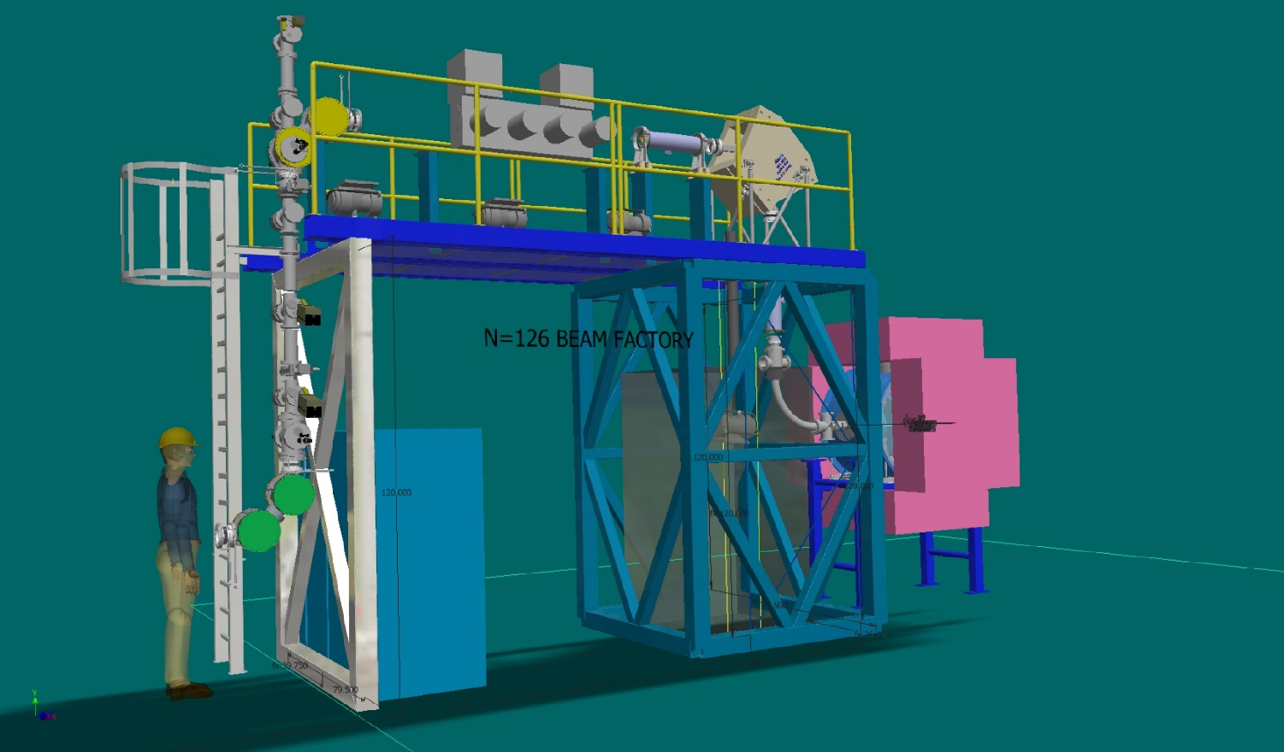
Existing devices
ANL N=126 factory
KEK Isotope Separation System (KISS)
Jyväskylä MNT gas cell
Notes:
We are not going to reinvent what already exists.

Slide 14
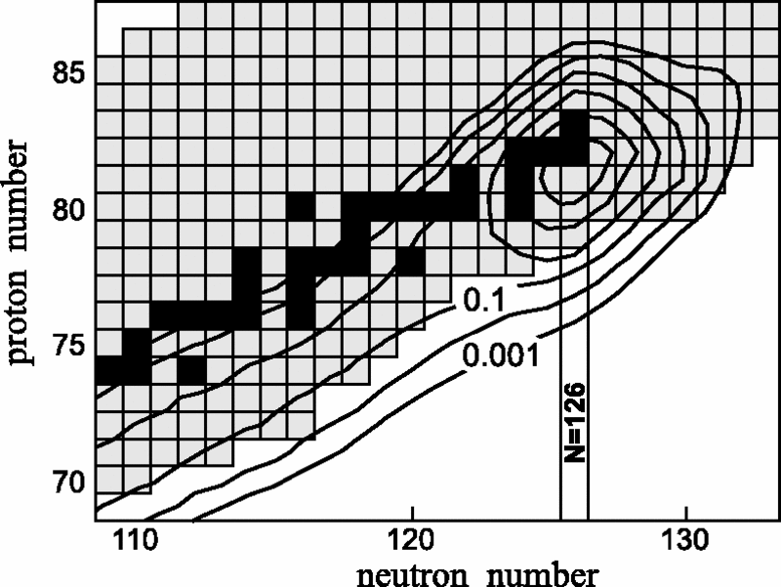
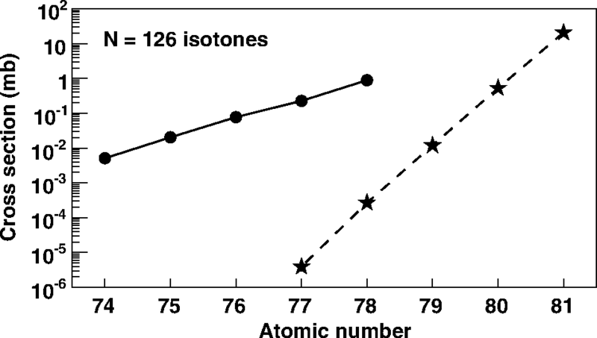
Other regions of interest
N = 126
¹³⁶Xe+¹⁹⁸Pt ∼8 MeV/A
²⁰⁸Pb(1 GeV/A)+Be
Zagrebaev and Greiner PRL 101 (2008) 122701
VAMOS, Watanabe et al. PRL 115 (2015) 172503

Slide 15
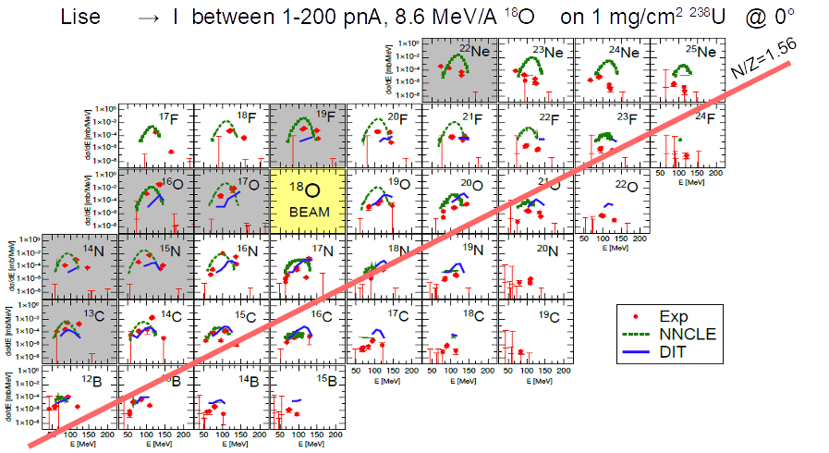
Other regions of interest
Light nuclei
LISE ¹⁸O + ²³⁸U @ 8.6 MeV/A
I. Stefan et al. PLB 779 (2018) 456

Slide 16
NUPECC LPR 2024
Utilizing Multi-Nucleon Transfer Reactions to access the terra incognita
T. Dickel^{1,2}, A. Kankainen³, E. Vardaci^{4,5}, A. Algora⁶, A. Andreyev⁷, P. Constantin⁸, D. Curien⁹, A. Di Nitto^{4,5}, T. Eronen³, J. Even¹⁰, H. Geissel^{1,2}, M. Gorska¹, P. Giubellino¹, E. Haettner¹, C. Hornung¹, B. Jonson¹¹, N. Kalantar-Nayestanaki¹⁰, S. Kraft-Bermuth¹², D. Kumar¹, T. Kurtukian-Nieto¹³, A. Lemasson¹⁴, R. Lozeva¹⁵, I. Mardor^{16,17}, I. Martel¹⁸, A. Morales⁶, A. Navin¹⁴, S. E. A. Orrigo⁶, Z. Patyk¹⁹, W. Plaß^{1,2}, H. Penttilä³, J. Piot¹³, Zs. Podolyak²⁰, M. P. Reiter²¹, S. Sanjari¹, H. Savajols¹⁴, C. Scheidenberger^{1,2}, R. S. Sidhu^{1,21}, B. Sulignano²², S. Szilner^{23,} C. Theisen²², K. Wimmer¹, J. J. Valiente Dobon²⁴, A. Zadvornaya²
¹GSI, Darmstadt, Germany; ²JLU Gießen, Germany; ³University of Jyväskylä, Finland; ⁴Università degli Studi di Napoli “Federico II”, Italy; ⁵INFN Sezione di Napoli, Napoli, Italy; ⁶IFIC, Valencia, Spain; ⁷University of York, York, UK; ⁸IFIN-HH/ELI-NP, Magurele, Romania; ⁹IPHC, Strasbourg, France; ¹⁰University of Groningen, Groningen, The Netherlands; ¹¹Chalmers University, Gothenburg, Sweden; ¹²THM, Gießen, Germany; ¹³LP2i Bordeaux, CNRS Université de Bordeaux, 19 chemin du Solarium CS10120 33170 Gradignan; ¹⁴GANIL, France; ¹⁵IJCLAB, Orsay, France; ¹⁶TAU, Tel-Aviv, Israel; ¹⁷Soreq NRC, Yavne, Israel; ¹⁸University of Huelva, Huelva, Spain; ¹⁹National Centre for Nuclear Research, Warsaw, Poland; ²⁰University of Surrey, UK; ²¹University of Edinburgh, UK; ²²CEA, France; ²³Ruder Boskovic Institut, Zagreb, Croatia; ²⁴LNL INFN, Italy

Slide 17
Merci de votre attention
Many thanks to D. Ackermann, P. Delahaye, H. Savajols, I. Stefan, B. Sulignano et al.

