Slide 1
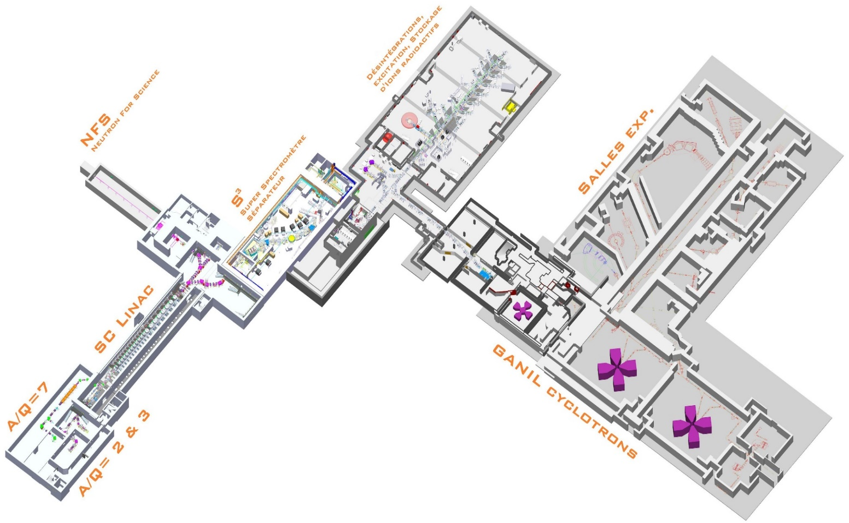
The CYREN pre project
Cylotron RENovation
G de France, G Sénécal

Slide 2
Context
From Omar Kamalou’s talk:
Internal DOD maintenance review => white book
Social context mid 2021 (heavy workload, missing manpower, large number of projects,…)
Funding agencies (triggered the context) decided to take some actions
In particular R Cledassou (IN2P3) and Ph Rebourgeard (IRFU) led a working group to analyze the GANIL activities over the period 2022-2030
Principally due to Water leak Inside the machine (CSS, chapeau de gendarme, MSE3,…) and more!!

Slide 3
Context
Analysis limited to GANIL including SPIRAL2 Phase 1++. Not future projects discussed in the « Comité Spiro »
The WG issued some recommandations and in particular « vigourous actions of cyclotrons renovation, to maintain them in operational condition over the next 20 years . Such a project should be conducted in the framework of a pluriannual project »
The physics motivations were then discussed within the Physics Group, with the CIMAP and finally within the community (the present GCM)

Slide 4
Physics Motivations
From yesterday ’s talks:
Fission program at VAMOS with PISTA+2nd arm. Challenge of the 100 ps time resolution to identify the mass within 1 mass unit. Also ideas on gas target. Significant revival of fission studies to reach even pre-scission neutrons. Accompanied by impressive progresses on the theoretical side.
At LISE, an ambitious program is foreseen with the « brochette mode » (demonstrated during the LISE 2022 campaign) using the various appara: ACTAR, PARIS, EXOGAM, ZDD, MUGAST… Already ideas of upgrade using modified FAZIA modules and electronics.
In particular with GRIT where several ideas are under discussion (4n and IAS in 4H, clusters, isoscalar pairing in transfer reaction using a cryognenic target, (3He,d) reaction to simulate proton transfer for astrophysical purposes,…
The ACTAR TPC collaboration has also shown some very interesting perspectives to study cluster physics and astrophysics in resonant scattering experiments: search narrow resonances, cluster structures in 11B, MED in A=35; excitation of collective modes like GMR or soft compression induced by inelatic scattering experiments

Slide 5
Physics Motivations
From yesterday ’s talks (continued):
INDRA-FAZIA: after the refurbishment of INDRA electronics, much better performances (better than anticipated). At relatively high energy, vaporization/clsuterization sources to study warm and diluted matter. Situation of collapsing supernovae/explosion of giant stars; external crust of neutron stars; neutrino transport properties… At medium energy, isospin transport and symmetry energy: EoS and impact on signals observed in GW from the fusion neutron stars…
Discussion on AGATA@GANIL: strong motivations for GRIT; for VAMOS.
Gas cell to study MNT: probably a program to start using heavy beams. Strong competition (ANL, JYFL, KISS,…)
A key prerequisite is to have new SP1 beams
+DESIR physics case (discussed Friday)

Slide 6
Physics Motivations
From today ’s talks :
Interdisplinary physics is critically important in the physics program of GANIL. Very strong request to have reliable working conditions of the CSSs to study:
Diluted matter, molecules, clusters
Radiochemistry, astrochemsitry
Material for energy
Nanostructuration/nanopores
Radiobiology, hadrontherapy
Need very large energy range, large LET (projectiles)
New projects/continuation:
PEPR ORIGINS
Double beam modality
Animal facility
Flash irradiation
Long term programs in astrochemistry/MIRRPLA PEPR led by CIMAP/many teams interested
Stopping power of ultrathin layer/beam diagnostics after the target
➔ ARIBE, IRRSUD, CSS1/SME, CSS2 unique combinations + new modalities
Notes:
Programmes et Equipement Prioritaires pour la Recherche
ORIGINS: la détection et caractérisation d’exoplanètes par imagerie directe ; l’analyse d’échantillons spatiaux, avec ou sans risques biologiques ; l’étude de la Terre dans sa globalité comme planète habitable ; l’expérimentation de laboratoire en exobiologie et la bio-analyse d’échantillons de la Terre ou Mars anciens ; et la modélisation numérique et l’analyse de données.

Slide 7
Conclusions
For nuclear physics or interdisciplinary physics:
A rich scientific program, with many new ideas,
adressing hot questions,
running at all GANIL energies (from ARIBE to CSS2)
A large community which needs:
Stable and radioactive beams (SP1) to conduct its programs
Large divesrity of accelerated ions (from the lightest to the heaviest)
Beam time (PAC pressure)
Reliable accelerators
Powerful instrumentation, at the top of the technology
A refurbishment accompanied by upgrades?
New injector? => B Jacquot
High power target at LISE? => JC Thomas
Low energy RIB, FULIS? => F De Oliveira

